Slide 1
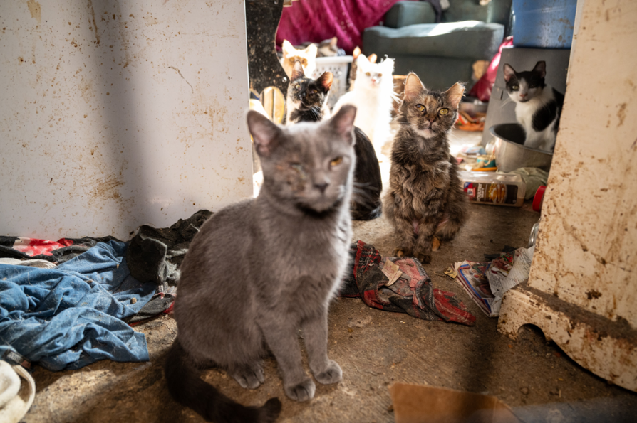
2.1.7. Describe the general characteristics of large-scale animal neglect
Credit: Meredith Lee/The HSUS

Slide 2
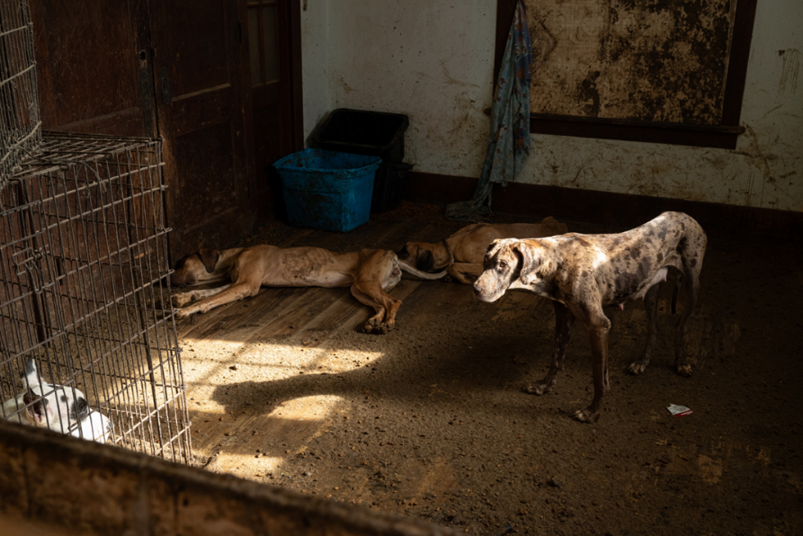
2.1.7. Describe the general characteristics of large-scale animal neglect
Credit: Meredith Lee/The HSUS

Slide 3
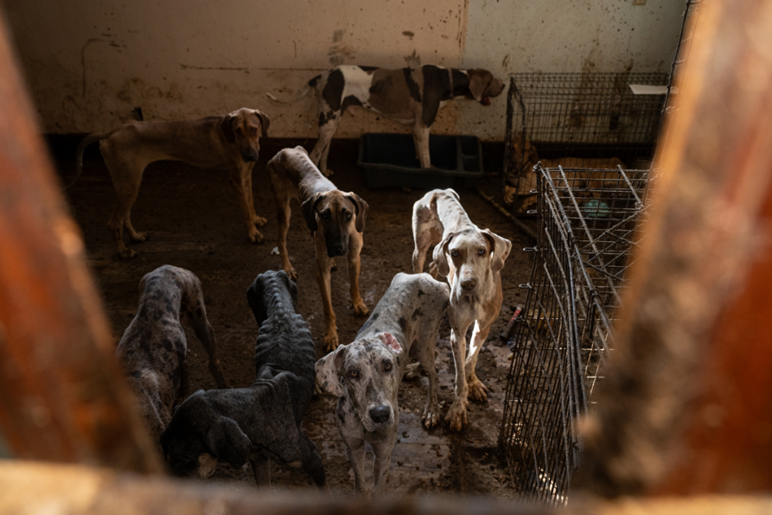
2.1.7. Describe the general characteristics of large-scale animal neglect
Credit: Meredith Lee/The HSUS

Slide 4
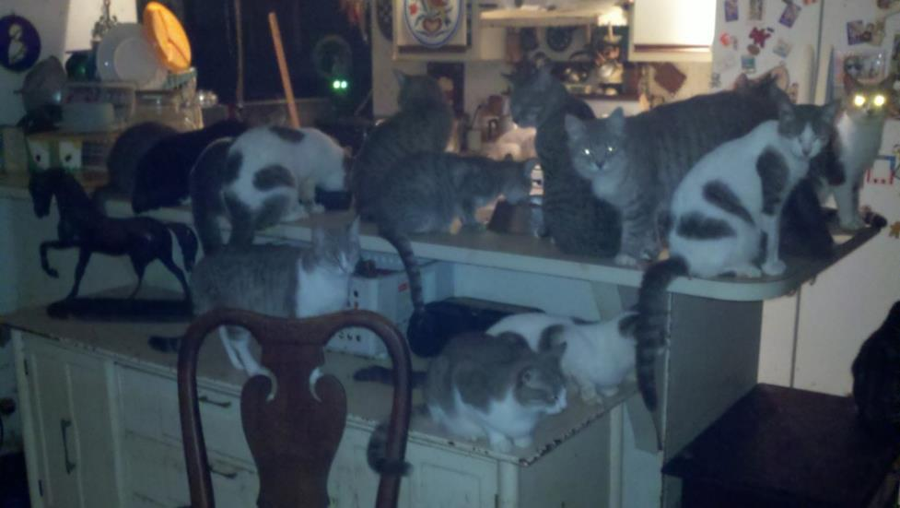
2.1.7. Describe the general characteristics of large-scale animal neglect
Credit: Adam Leath

Slide 5
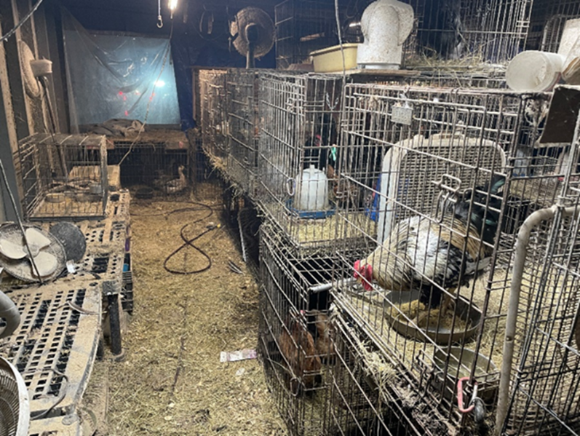
2.1.7. Describe the general characteristics of large-scale animal neglect
Credit: Polk County Sheriff’s Office

Slide 6
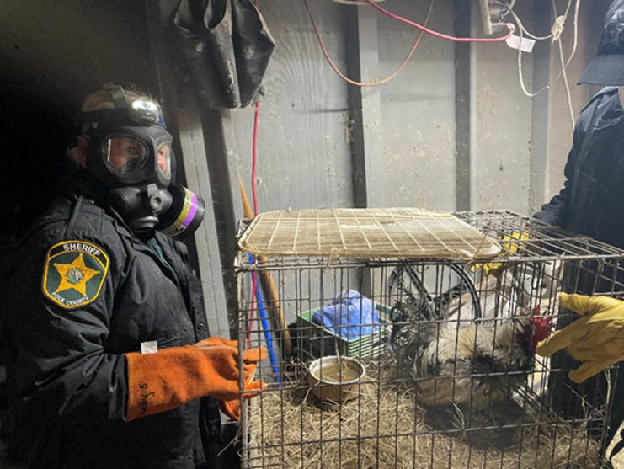
2.1.7. Describe the general characteristics of large-scale animal neglect
Credit: Polk County Sheriff’s Office
Depiction of proper PPE when handling cases of large-scale animal neglect.

Slide 7
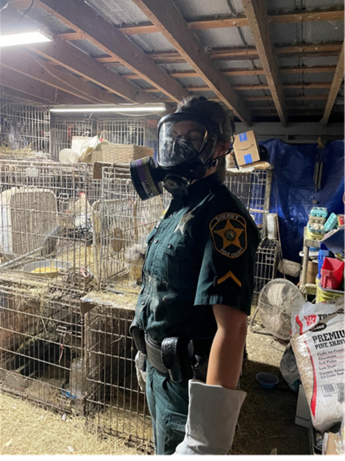
2.1.7. Describe the general characteristics of large-scale animal neglect
Credit: Polk County Sheriff’s Office
Depiction of proper PPE when handling cases of large-scale animal neglect.

