Slide 1
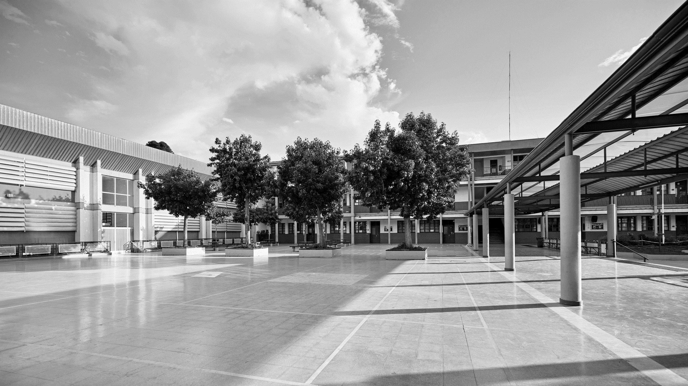
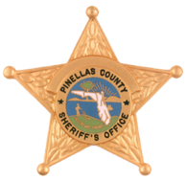
PINELLAS COUNTY SHERIFF’S OFFICE
SAFETY & SECURITY FOR FLORIDA’S PRIVATE SCHOOLS

Slide 2
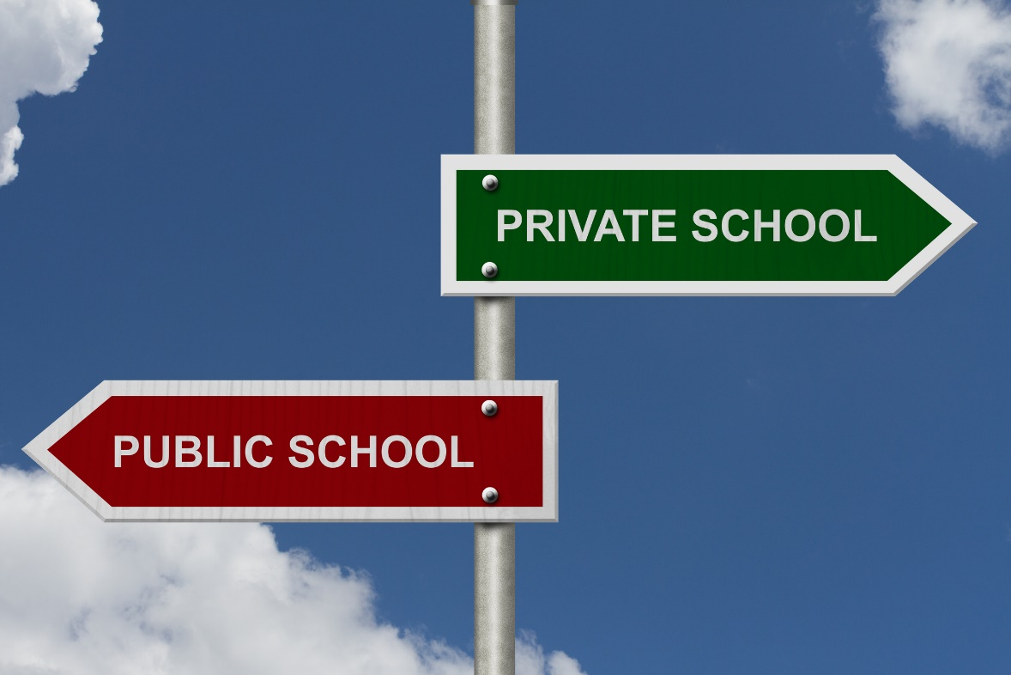
PRIVATE SCHOOLS ARE STILL VULNERABLE
Private school students are no less vulnerable than public school students and private schools are no less susceptible to attack than public schools.
However, across Florida private school security has not kept pace with the improvements made to the safety and security in public schools.
PINELLAS COUNTY SHERIFF’S OFFICE

Slide 3
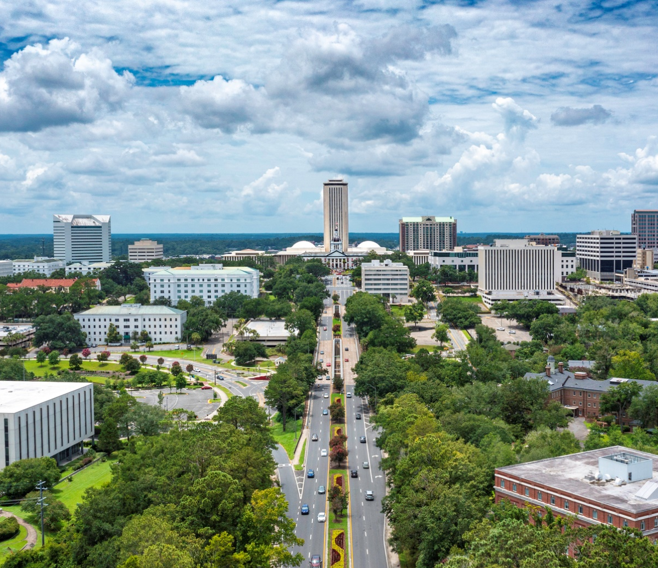
SENATE BILL 7026
In March 2018, the Florida Legislature passed SB7026.
This bill changed the landscape of school safety in Florida’s public schools – traditional public schools and charter schools.
Every year since 2018, the Legislature has passed school safety legislation that mandates certain measures improving public school safety.
PINELLAS COUNTY SHERIFF’S OFFICE

Slide 4
LIMITED IMPACT ON PRIVATE SCHOOLS
Until 2023, none of the legislation has impacted private schools.
The legislation still does not mandate the safety measures for private schools that are required for public schools, but it does “authorize” and helps pay for some safety measures.
In 2023, the Pinellas County Sheriff’s Office implemented a program to provide private schools with the same level of security that exists in public schools.
PINELLAS COUNTY SHERIFF’S OFFICE

Slide 5
TWO MAIN ELEMENTS OF SCHOOL SAFETY
Harm Mitigation – being prepared for a school attack and doing everything possible to mitigate harm by stopping it as soon as it starts.
Harm mitigation includes physical site hardening, an active response policy and drills, communication devices, and classroom best practices such as “safe areas,” locked doors, and opaque window coverings.
Prevention – the ultimate goal and the single greatest opportunity to prevent a school attack is threat management.
PINELLAS COUNTY SHERIFF’S OFFICE

Slide 6

OUR PRIVATE SCHOOL SAFETY & SECURITY PROGRAM
Pinellas County’s private school safety and security program is adaptable statewide.
We have about 160 private schools across the county and the first thing we did was to invite all the private school administrators to a meeting where we explained the initiative and offered services.
PINELLAS COUNTY SHERIFF’S OFFICE

Slide 7

FOUR ESSENTIAL COMPONENTS
Physical Site Security Assessments
Active Assailant Policy, Plan, and Drills
Guardian Program
Threat Management Teams
PINELLAS COUNTY SHERIFF’S OFFICE

Slide 8
PHYSICAL SITE SECURITY ASSESSMENTS
Deputies trained in doing these assessments conduct them at participating schools.
During the assessment they evaluate the perimeter, exterior, and interior of the campus and its buildings.
Deputies then provide the school with a comprehensive report that identifies their strengths, weaknesses, and opportunities.
Any critical gaps are also identified, and deputies will follow-up with them to the extent they want help implementing the best practices.
PINELLAS COUNTY SHERIFF’S OFFICE

Slide 9
Site Assessment Tool
We developed a site assessment tool that detectives use to measure vulnerabilities in the school’s safety and security practices. This assessment tool evaluates risks related to a potential active assailant event.
Recommendations are made to improve school safety and are identified in the report as priority level low, medium, high, and no action required (NAR).
Low - minor importance to the school’s overall security. Items with a low priority may also be cost-prohibitive to address, making the change unrealistic, or the change may unrealistically require significant policy changes.
Medium - may impact key components of security at the facility. The issues addressed within this category may not require immediate action, but they should be addressed during future annual planning.
High - may critically impact the school’s overall security, response, or recovery from an active assailant event. These items do not constitute an immediate life safety concern, but these items should be urgently addressed.
PINELLAS COUNTY SHERIFF’S OFFICE

Slide 10
ACTIVE ASSAILANT POLICY, PLAN, & DRILLS
Deputies help the schools establish a comprehensive active assailant response plan that includes a policy, training for students and staff, and development of and support for regular drills.
Effective training requires “muscle memory” and regular training is a crucial component of effective school safety.
We know that people react how they train, and in the case of an active assailant on campus, if schools don’t have a response plan and people don’t regularly train on it, they will not react or certainly not react effectively.
“Failing to plan is planning to fail.”
An active assailant response plan and drills are essential.
PINELLAS COUNTY SHERIFF’S OFFICE

Slide 11
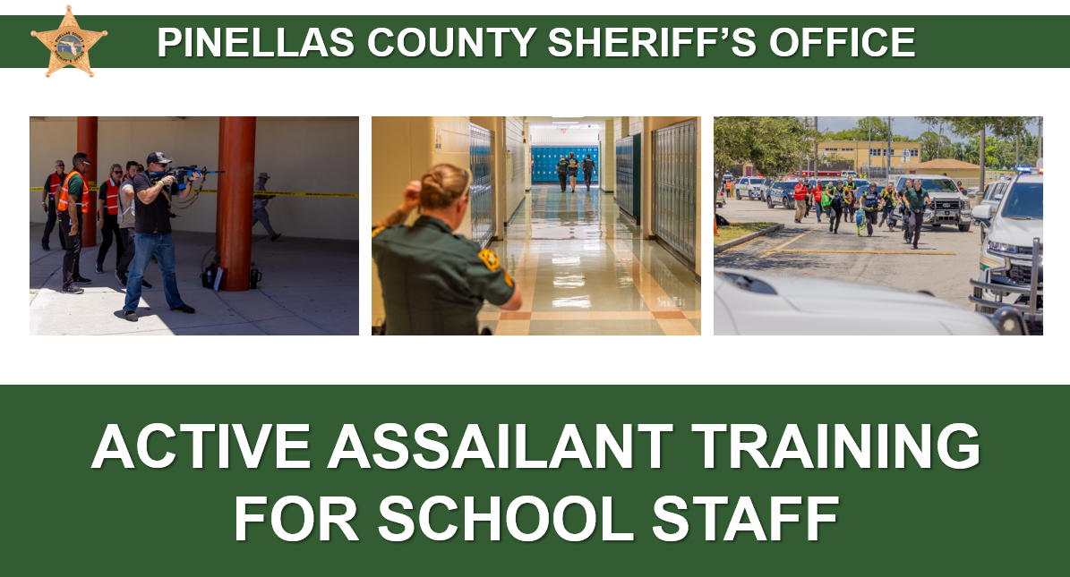
ACTIVE ASSAILANT PRESENTATION
Mass Casualty Planning Unit Detectives provide school staff members with a comprehensive PowerPoint presentation related to best practices learned pertaining to sight hardening, mitigation, hard corners, evacuations routes, and rally points.
PINELLAS COUNTY SHERIFF’S OFFICE

Slide 12
GUARDIAN PROGRAM
Florida law requires a Safe School Officer (SSO) on all 4,000 public school campuses in the state. This is accomplished by having a law enforcement officer (SRO) or a Guardian on every school campus.
Starting in 2023, Florida law permits Guardians on all Florida K-12 private school campuses. Prior to that, a private school’s only options were a paid police officer or security guard if they wanted an armed person on campus.
Guardians may be uniformed personnel or in plain clothes.
They may be fulltime Guardians, or they may be existing school employees who perform the function as a collateral responsibility.
The requirements for Guardians at private schools mirror those at public schools.
PINELLAS COUNTY SHERIFF’S OFFICE

Slide 13
GUARDIAN PROGRAM (CONT’D)
Under Florida law, the Guardian academy is about a month long and is a minimum of 144 hours.
To qualify, the person must be employed by the school and appointed and trained by the sheriff.
City police departments cannot approve or train Guardians.
In Pinellas County, we issue the private school Guardians guns and related equipment at no cost to the school ensuring firearm consistently.
Guardians are also issued police radios so they can communicate directly with law enforcement agencies responding to an incident at the school.
We have a dedicated School Guardian Unit that works with the private school Guardians on a regular basis.
PINELLAS COUNTY SHERIFF’S OFFICE

Slide 14
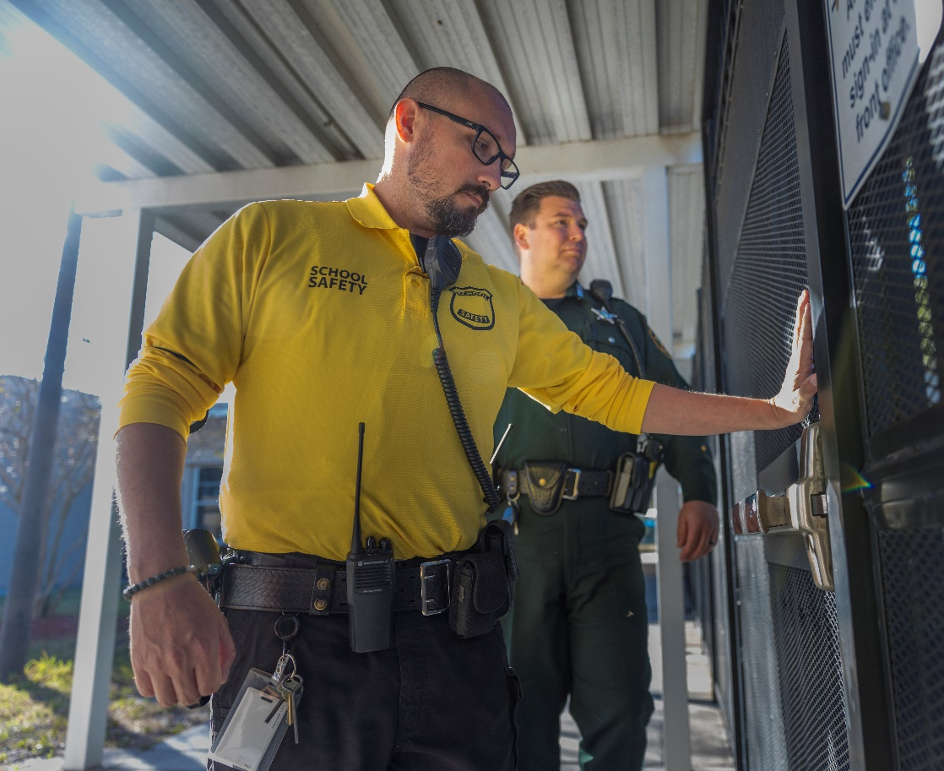
GUARDIAN PROGRAM (CONT’D)
Many private school employees in Pinellas County have successfully completed our Guardian academy and are in place at private schools across the county.
Across Florida, sheriffs in about 18 of the 67 counties have trained and certified Guardians who are in place at private schools in their counties.
PINELLAS COUNTY SHERIFF’S OFFICE

Slide 15
THREAT MANAGEMENT
Florida law has required threat management teams in every public school since March of 2018. They are not required in private schools and have, for the most part, not existed in private schools across the state.
Using a version of the Florida Model modified for private schools, we establish and provide ongoing support for a threat management program at private schools across the county.
We provide the training and structure for the threat management program.
The school must provide the personnel to staff the team (i.e., administrator or teacher). We provide the law enforcement officer. If the school does not have a mental health professional, we will provide one from our Mental Health Unit to participate on the team.
PINELLAS COUNTY SHERIFF’S OFFICE

Slide 16

PROGRAM RECAP
The private school safety and security program includes:
Physical Site Security Assessments
Active Assailant Policy, Plan, and Drills
Guardian Program
Threat Management Teams
PINELLAS COUNTY SHERIFF’S OFFICE

Slide 17
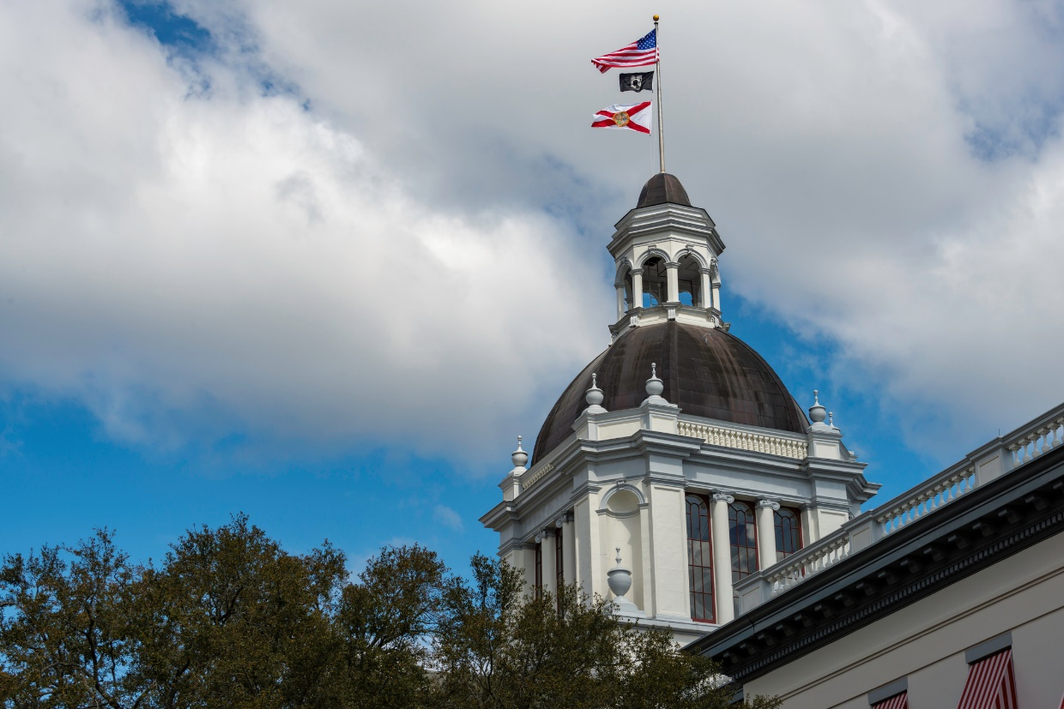
HOUSE BILL 1473
House Bill 1473 passed during the 2024 Legislative Session and provides $5 million in state funding through the Florida Department of Law Enforcement (FDLE) for sheriff’s offices and police departments across the state to implement these school safety program components at private schools.
PINELLAS COUNTY SHERIFF’S OFFICE

Slide 18
SAFETY & SECURITY FOR FLORIDA’S PRIVATE SCHOOLS
QUESTIONS?
PINELLAS COUNTY SHERIFF’S OFFICE

