Slide 1
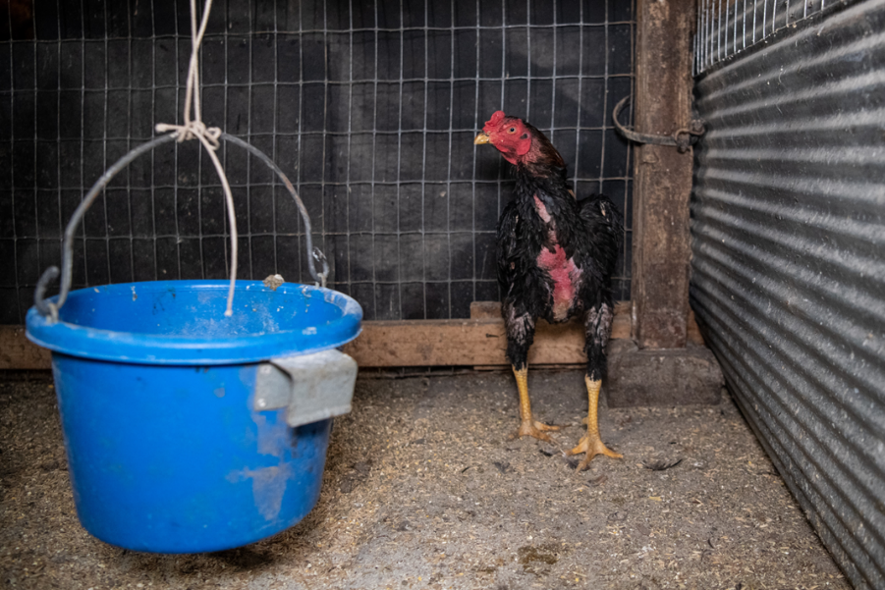
2.3.13. Describe the typical physical indicators of cockfighting or cockfighting preparations
Credit: Meredith Lee/The HSUS

Slide 2
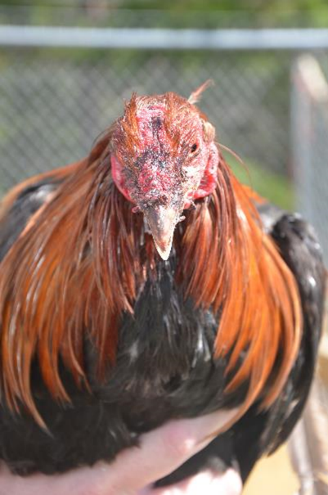
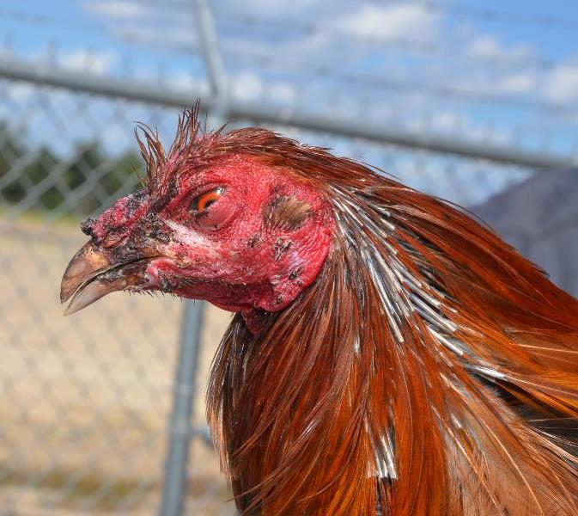
2.3.13. Describe the typical physical indicators of cockfighting or cockfighting preparations
Credit: Adam Leath
Credit: Adam Leath

