Slide 1
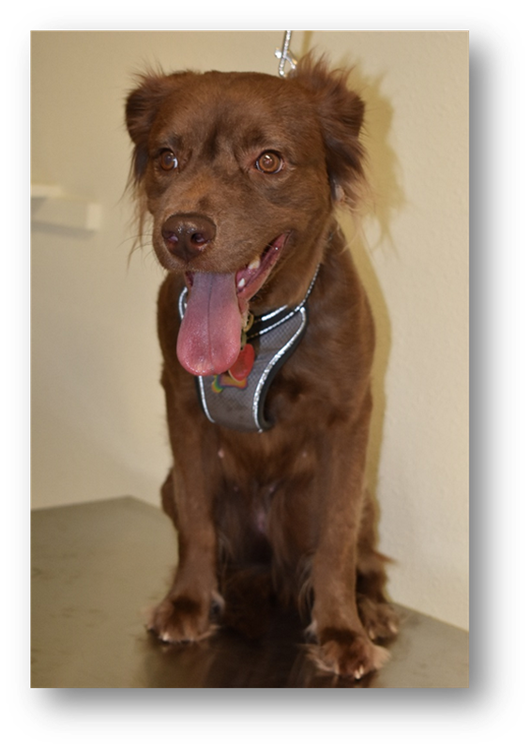
Mandatory Case Study—Sexual Abuse of a Female Dog (2020)
Credit: Adam Leath

Slide 2
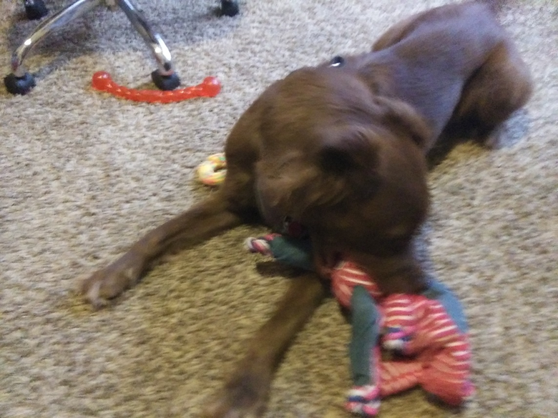
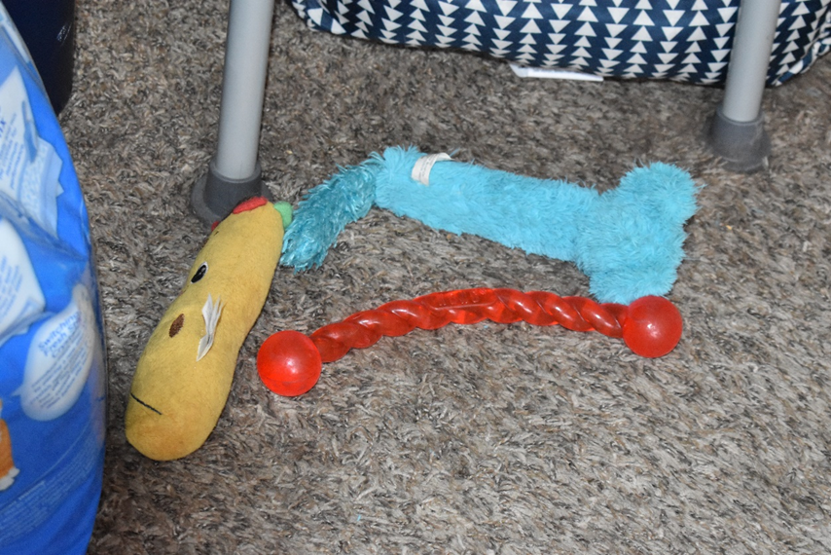
Mandatory Case Study—Sexual Abuse of a Female Dog (2020)
Credit: Adam Leath

Slide 3
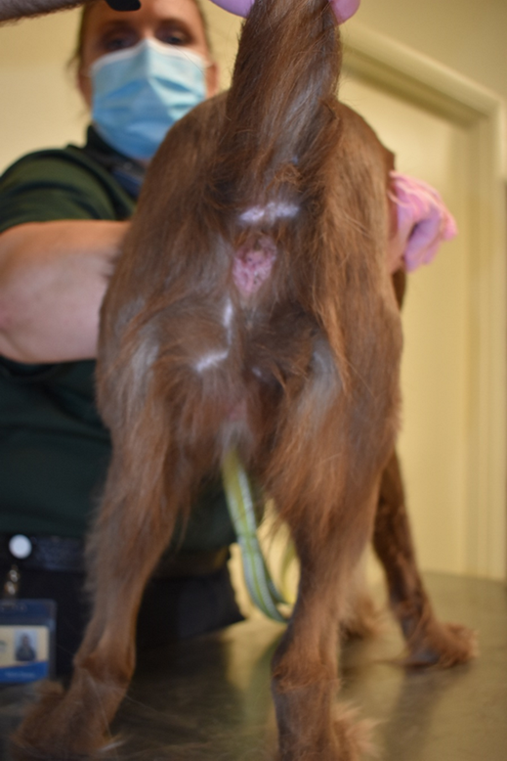
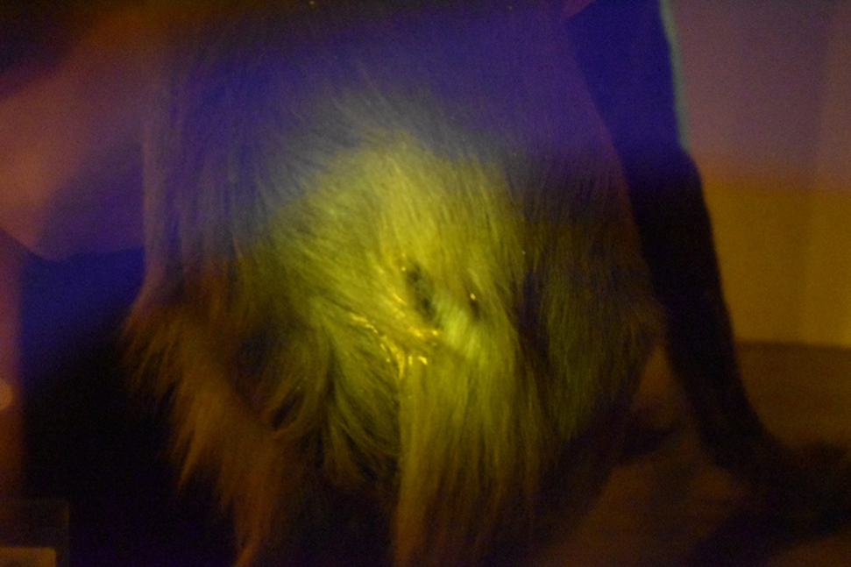
Mandatory Case Study—Sexual Abuse of a Female Dog (2020)
Credit: Adam Leath

Slide 4
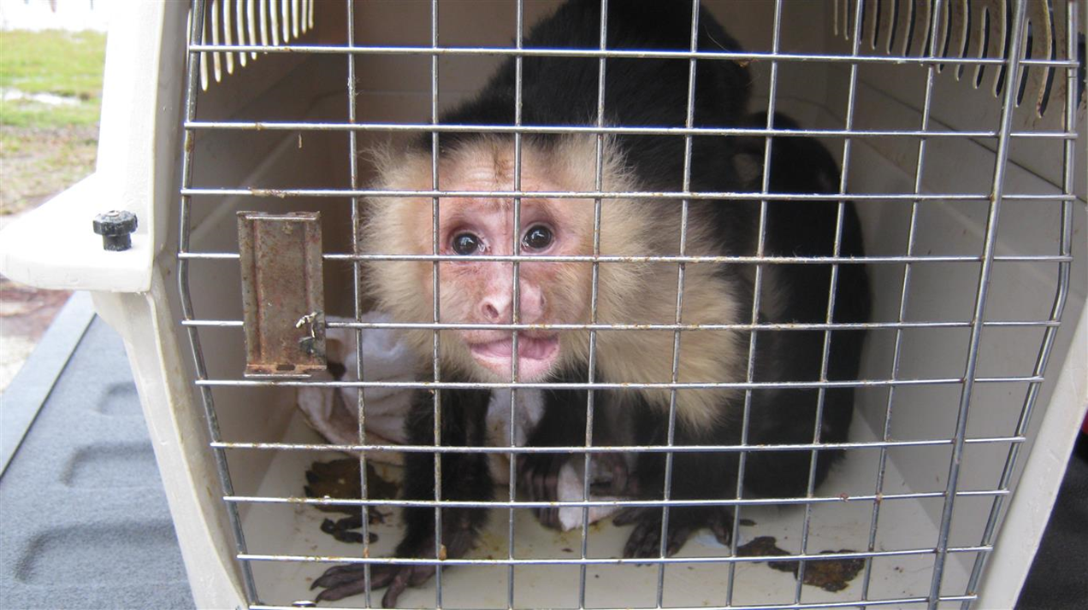
Mandatory Case Study—Capuchin Monkey Case (2016)
Credit: Florida Fish and Wildlife Conservation Commission

Slide 5
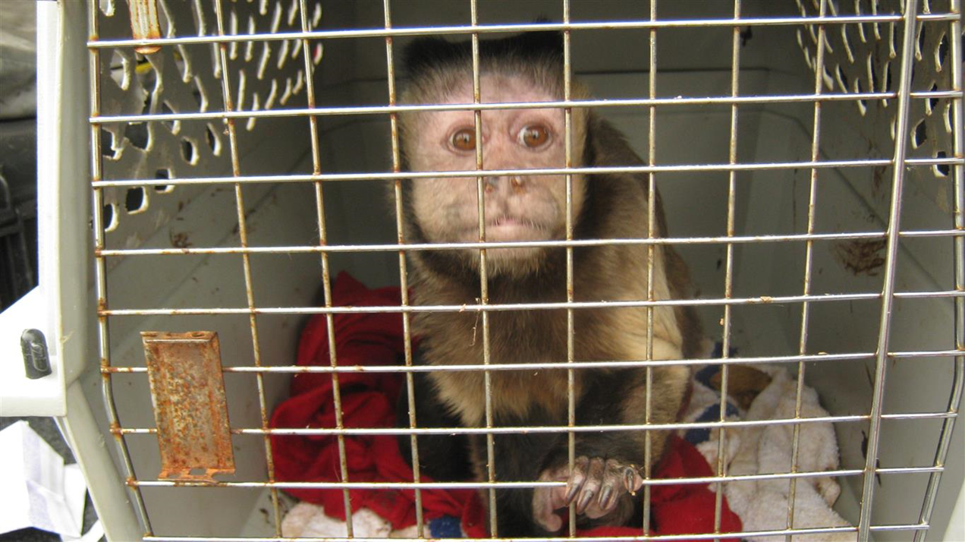
Mandatory Case Study—Capuchin Monkey Case (2016)
Credit: Florida Fish and Wildlife Conservation Commission

Slide 6
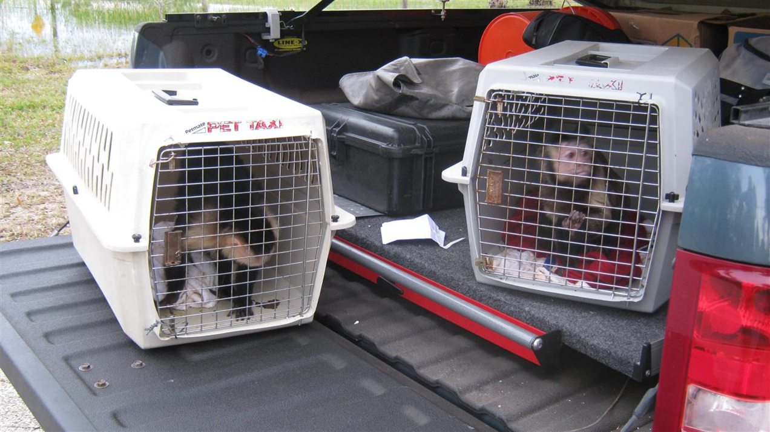
Mandatory Case Study—Capuchin Monkey Case (2016)
Credit: Florida Fish and Wildlife Conservation Commission

Slide 7
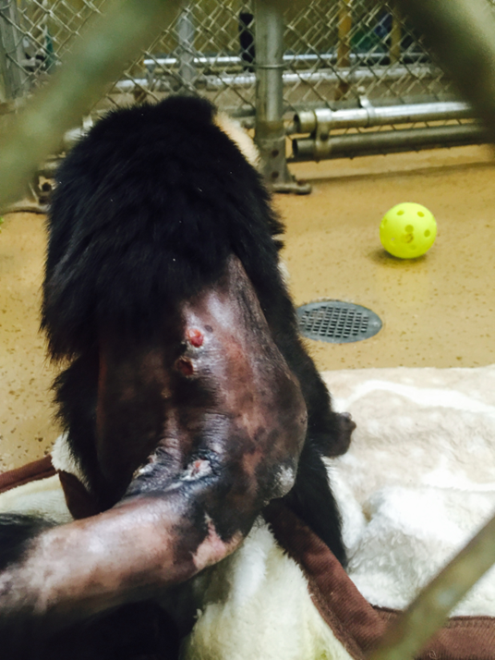
Mandatory Case Study—Capuchin Monkey Case (2016)
Credit: Florida Fish and Wildlife Conservation Commission

