Slide 1
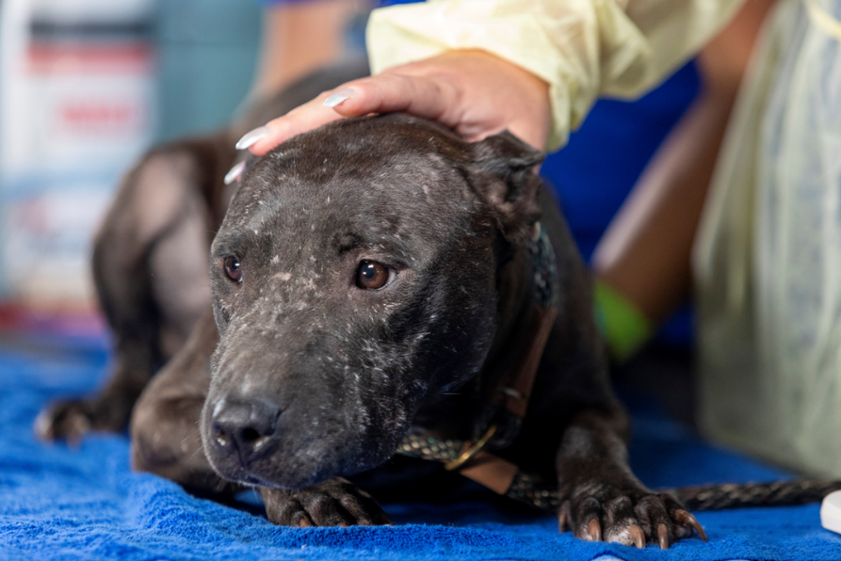
2.3.9. Identify the type of body scarring typically associated with dogfighting
Credit: Meredith Lee/The HSUS

Slide 2
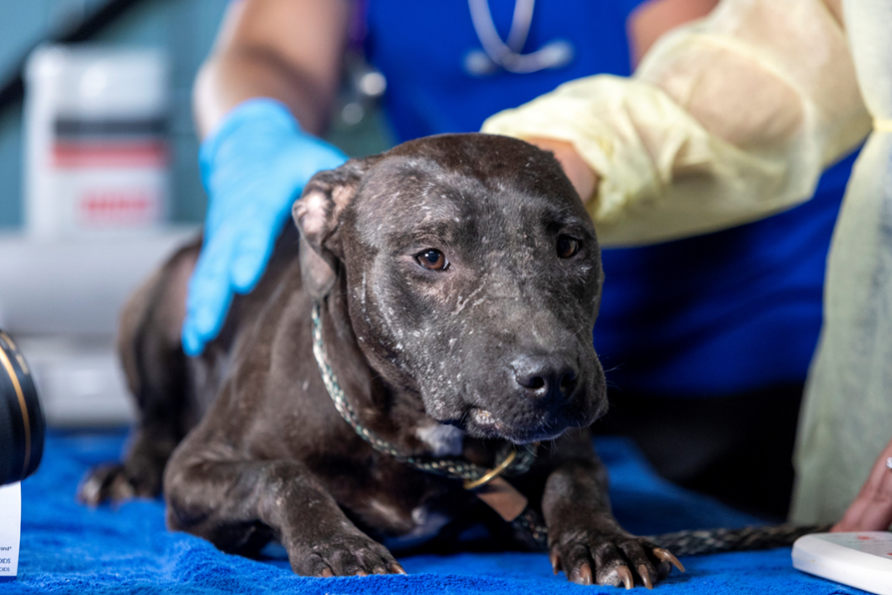
2.3.9. Identify the type of body scarring typically associated with dogfighting
Credit: Meredith Lee/The HSUS

