Slide 1
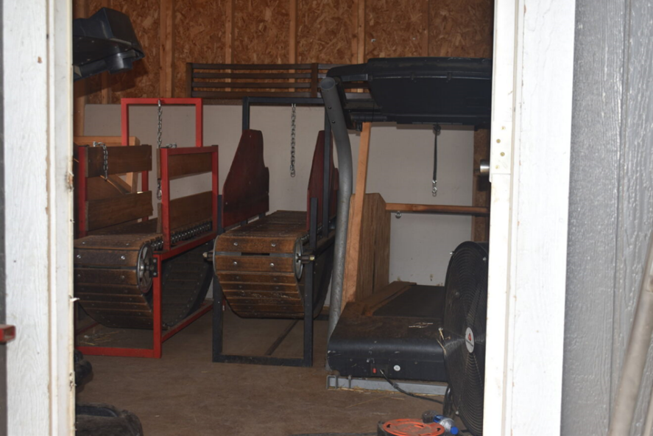
2.3.6. List the paraphernalia associated with dogfighting
Credit: Rachel Ide/The HSUS

Slide 2
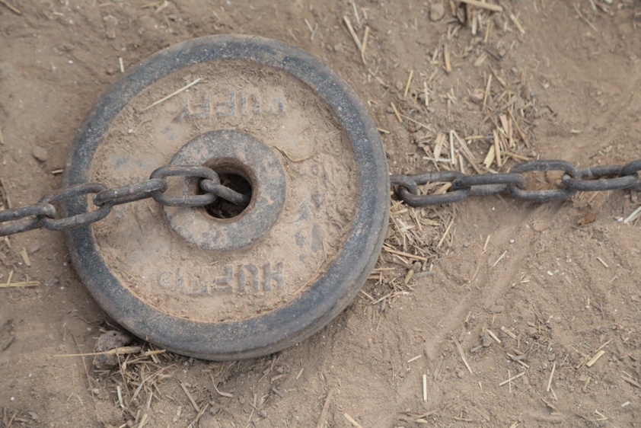
2.3.6. List the paraphernalia associated with dogfighting
Credit: Brent Clark/The HSUS

Slide 3
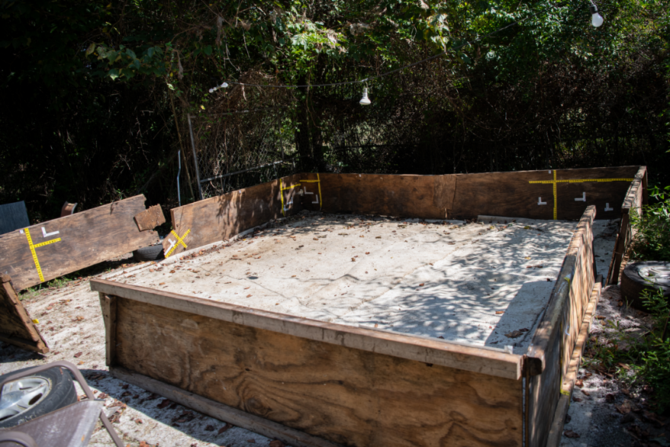
2.3.6. List the paraphernalia associated with dogfighting
Credit: Meredith Lee/The HSUS

Slide 4
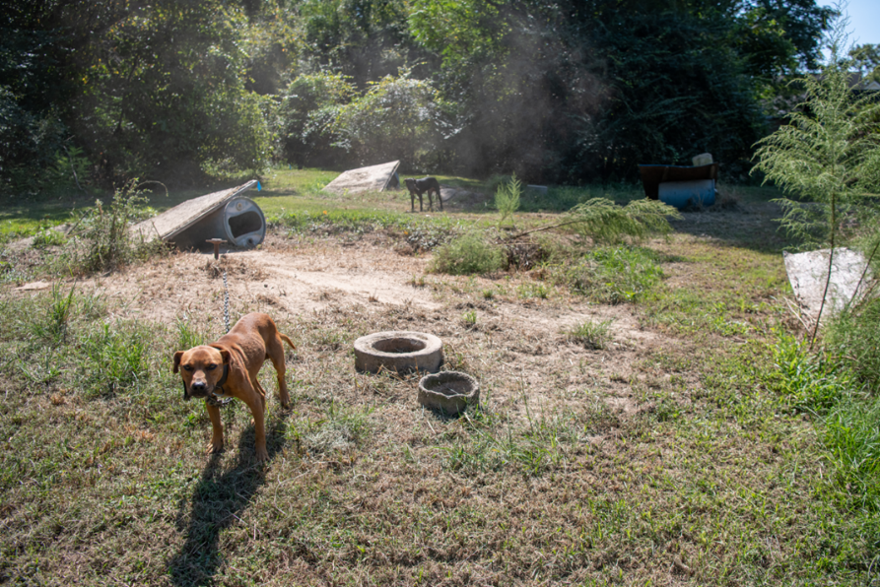
2.3.6. List the paraphernalia associated with dogfighting
Credit: Meredith Lee/The HSUS

Slide 5
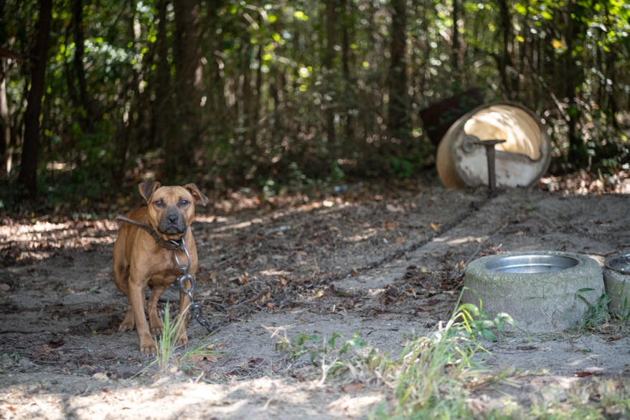
2.3.6. List the paraphernalia associated with dogfighting
Credit: Meredith Lee/The HSUS

Slide 6
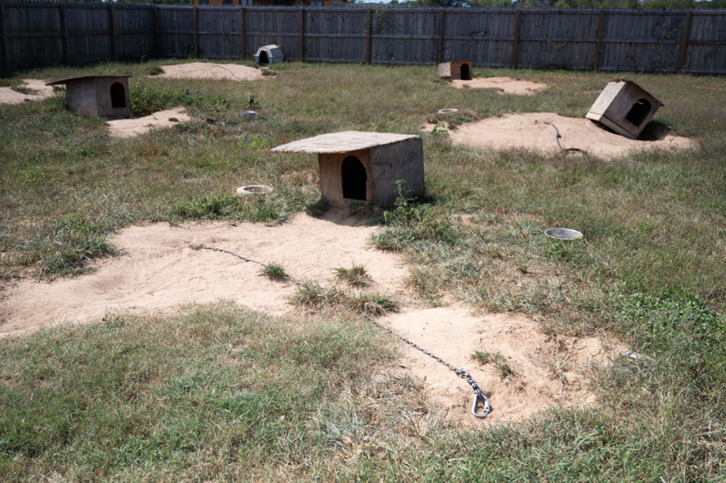
2.3.6. List the paraphernalia associated with dogfighting
Credit: Kevin Wolf/The HSUS

Slide 7
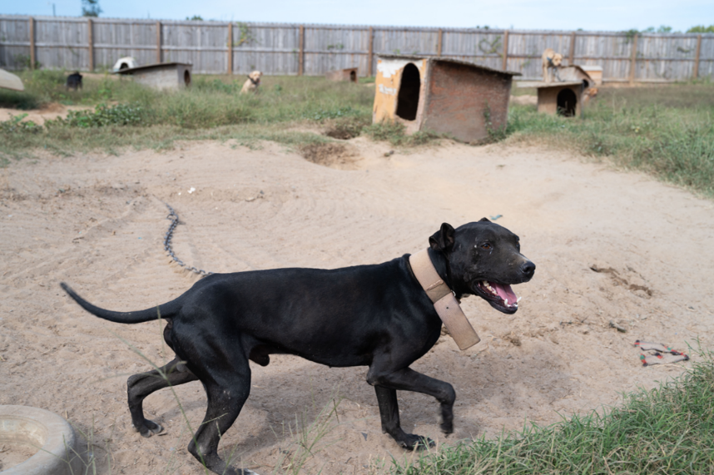
2.3.6. List the paraphernalia associated with dogfighting
Credit: Kevin Wolf/The HSUS

Slide 8
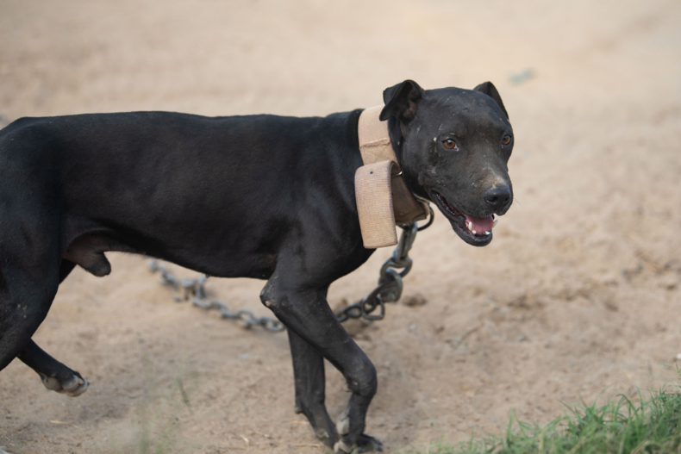
2.3.6. List the paraphernalia associated with dogfighting
Credit: Kevin Wolf/The HSUS

