Slide 1
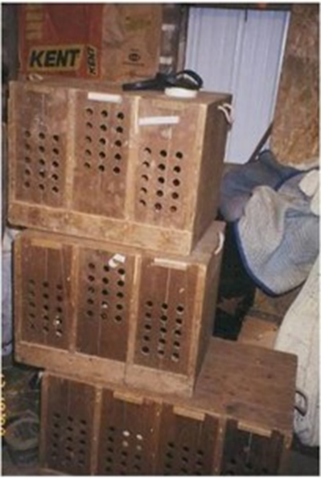
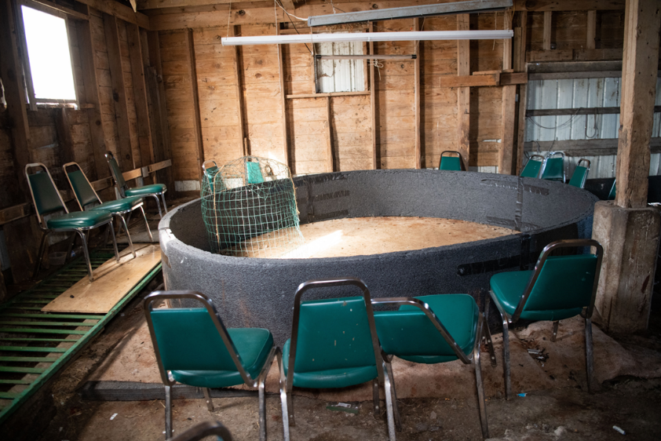
2.3.15. List the paraphernalia associated with cockfighting.
Credit: Adam Leath
Depiction of bird transport boxes.
Credit: Meredith Lee/The HSUS
Depiction of a cockfighting pit.

Slide 2
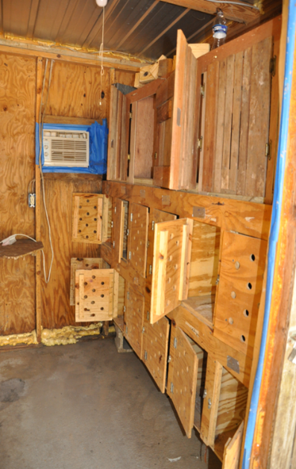
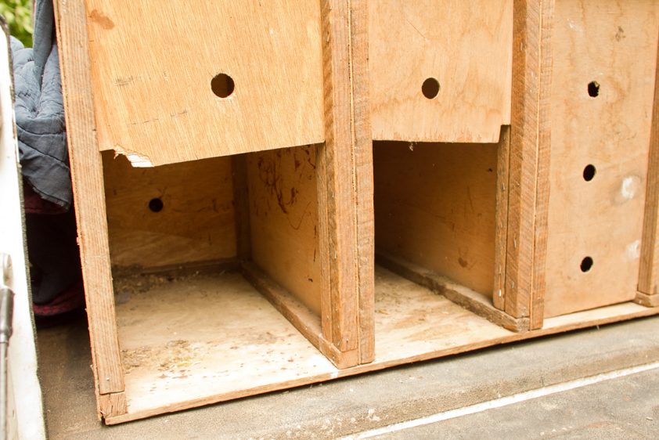
2.3.15. List the paraphernalia associated with cockfighting.
Credit: The HSUS
Credit: The HSUS

Slide 3
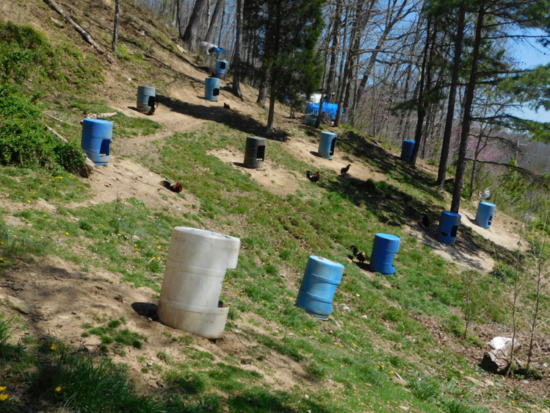
2.3.15. List the paraphernalia associated with cockfighting.
Credit: Heather Severt/HSUS

Slide 4
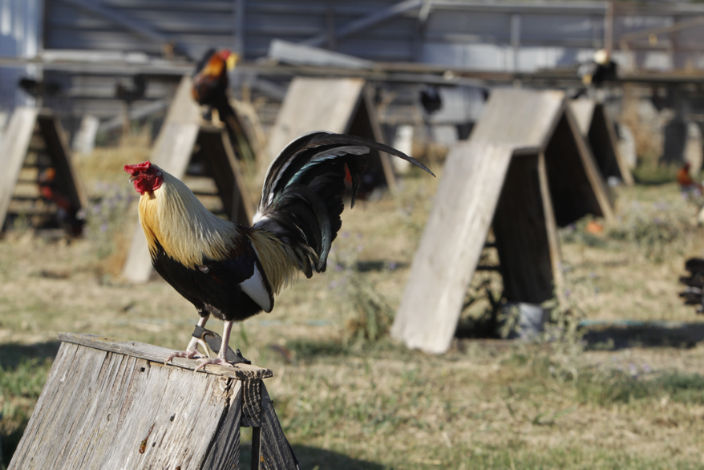
2.3.15. List the paraphernalia associated with cockfighting.
Credit: Alex Gallardo/The HSUS

Slide 5
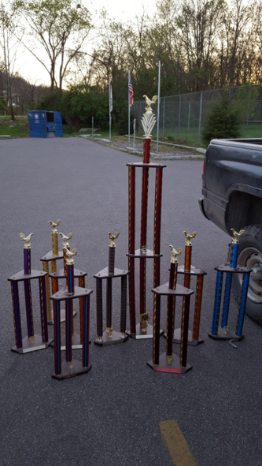
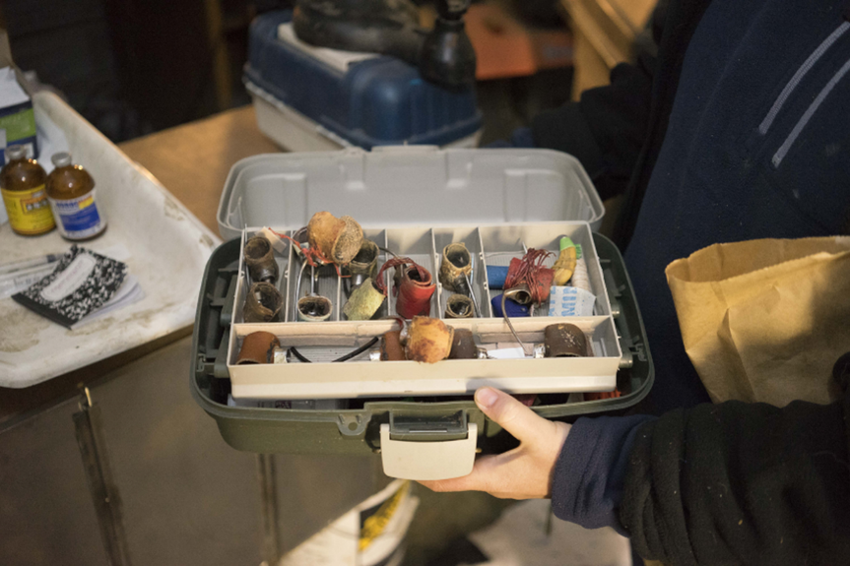
2.3.15. List the paraphernalia associated with cockfighting.
Credit: Heather Severt/The HSUS
Credit: Troy Tomlinson/The HSUS

Slide 6
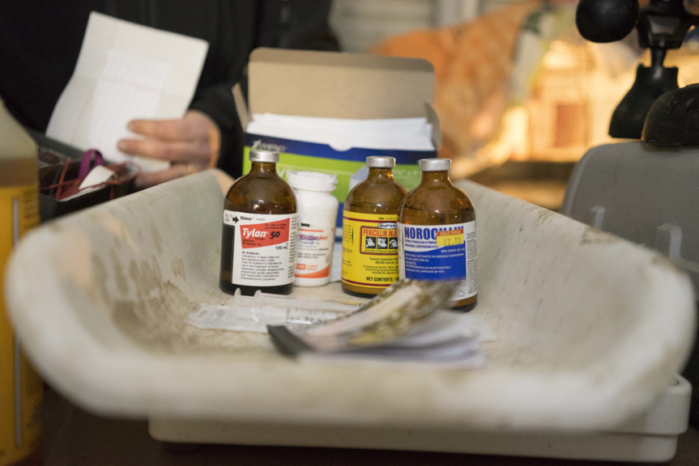
2.3.15. List the paraphernalia associated with cockfighting.
Credit: Troy Tomlinson/The HSUS

Slide 7
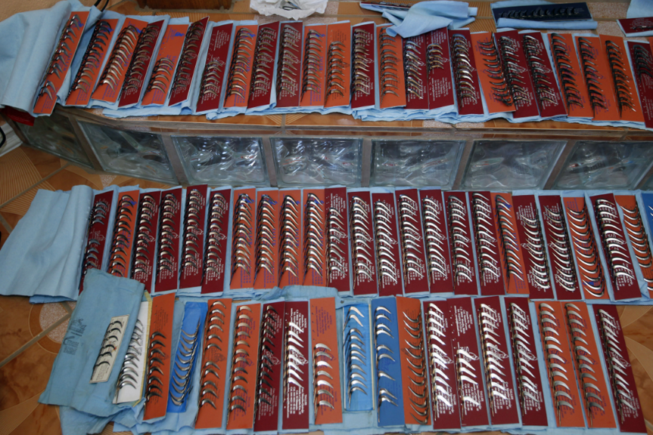
2.3.15. List the paraphernalia associated with cockfighting.
Credit: Troy Tomlinson/The HSUS

Slide 8
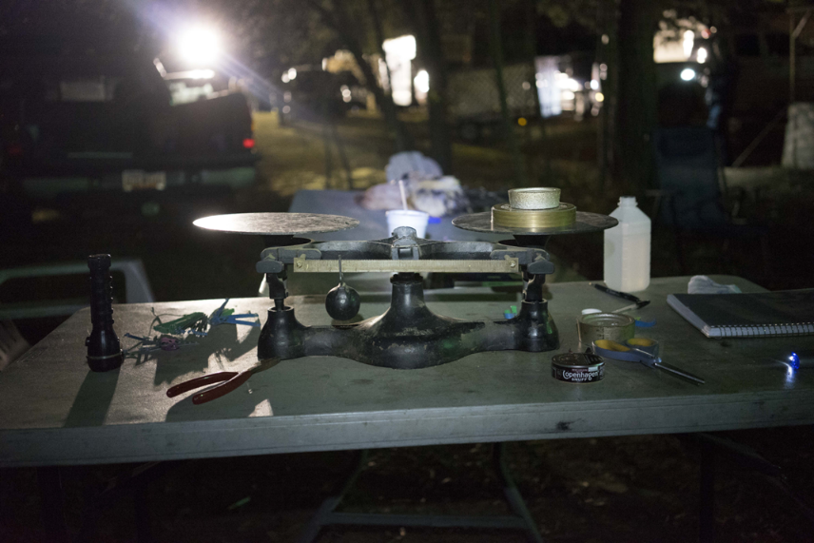
2.3.15. List the paraphernalia associated with cockfighting.
Credit: Troy Tomlinson/The HSUS

Slide 9
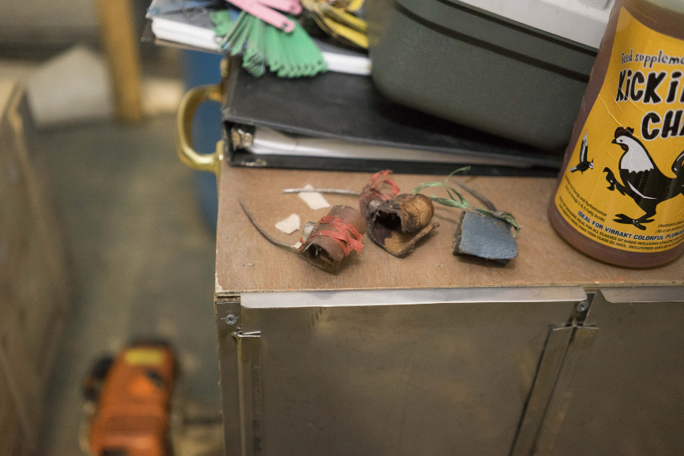
2.3.15. List the paraphernalia associated with cockfighting.
Credit: Alex Gallardo/The HSUS

