Slide 1


Slide 2
House Bill 301

Slide 3
HB301 (F.S. 1013.13) appropriated $14 million for statewide school mapping.
The funding was provided to the Department of Education (DOE) and made available to all school districts in the state.

Slide 4
Up until the State provided this funding there was no universal mapping for schools, or other critical infrastructure, in each county or school district.
The various law enforcement, fire/EMS, and other first responders, as well as the school districts, have used multiple mapping platforms in their areas of responsibility.

Slide 5

In counties with multiple law enforcement agencies, the different agencies used different maps.
There was also no consistency in the map orientation, what the maps contained, or verified labeling of buildings, hallways, doorways, classrooms, etc.

Slide 6
The mapping provided by the State funding is intended to provide a universal map, with true north orientation and a grid system overlay for all schools.
This standardized map will provide for consistency and efficiency in the response and command and control of active assailant and other critical events.

Slide 7
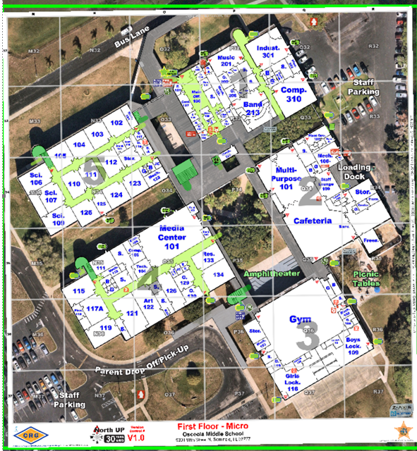
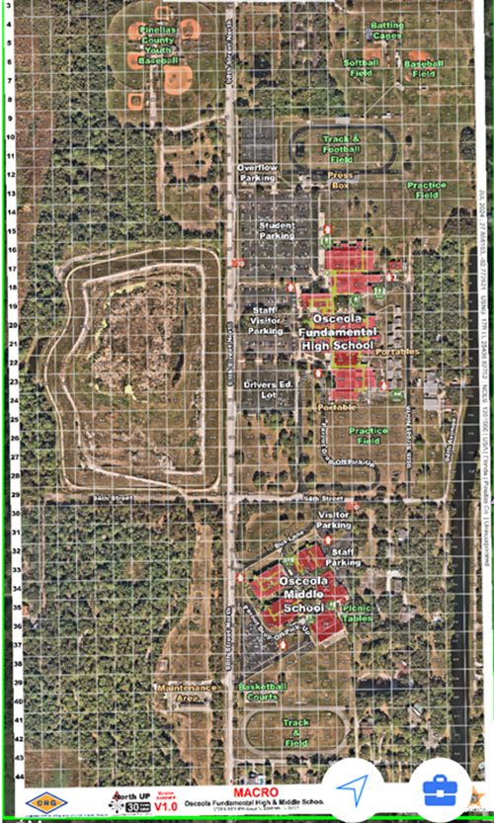

Slide 8
The law states that each school district “may apply” for the funding in “consultation with local law enforcement and public safety agencies (Fire/EMS).”

Slide 9
The law also states that the mapping data “must be provided in an electronic or digital format” and that it be “compatible with software platforms used by local, state, and federal public safety agencies that provide emergency services…without requiring such agencies to purchase additional software or requiring a fee to view or access the data.”

Slide 10
The mapping data must also “be compatible with security software platforms in use by the specific school for which the data is provided without requiring local law enforcement agencies or school districts to purchase additional software or requiring a fee to view or access the data.”

Slide 11
Further, the data, if requested, must be in a “digital file format that can be integrated into interactive mobile platforms in use.”
The maps must be overlaid on “current aerial imagery” and be “overlaid with grided x and y coordinates.”

Slide 12

There are three companies that provide mapping services to Florida school districts.
There are multiple companies that provide “software platforms” used by law enforcement for mobile maps on computer-aided dispatch systems (CAD) and other mapping programs.

Slide 13
There are multiple companies that provide “security software platforms” (Alyssa’s Alert providers) for Florida schools.
Not all of the systems of the companies providing mapping are compatible or interfaced with the law enforcement or school platforms.

Slide 14
The cost to map each school is about $3,000 and the various school districts received between thousands of dollars to over $1 million.
Broward County Public Schools (BCPS) contracted with Centegix to provide the school maps at a contract cost of $1.1 million.
Centegix is currently working with BSO to provide deputies with access to the maps.

Slide 15

The implementation of the mapping program has been inconsistent throughout the state and the different districts are in varying stages of implementation.

Slide 16
The funding under HB301 had to be expended by June 30, 2024, but in this year’s budget bill, the legislature extended the expenditure deadline to June 30, 2025.
All of the school districts and companies providing the maps need to continue working toward full compliance with the law and ensure all first responders have access to the maps on existing systems.
They also need to ensure that all the school districts have access to the maps through their current systems.
DOE Office of Safe Schools is currently conducting a compliance review.

