Slide 1

Chris Hixon, Coach Aaron Feis, and Coach Scott Beigel Guardian Program
Marjory Stoneman Douglas High School
Public Safety Commission
July 31, 2024
Tim Hay
Executive Director
Office of Safe Schools

Slide 2

2023 Legislative Changes
HB 543 – School Safety: Guardian Program
Section 30.15, Florida Statutes
Permitted private school Guardians.
Private schools are responsible for training costs.
The Guardian training is a standardized statewide curriculum.
Requirement for training hours changed slightly:
  Increase from 8 to 16 hours of active shooter/assailant scenarios, and
  Decrease from 12 to 4 hours of legal issues.

Slide 3
2024 Legislative Changes
HB 1473 – School Safety: Guardian Program
Section 30.15, Florida Statutes
Former law enforcement officers with current certification can serve as Guardians.
Twelve hours of de-escalation training is now part of the 144-hour Guardian training.
Sheriffs are required to report Guardian information to the Florida Department of Law Enforcement (FDLE).
Schools/districts are required to report Guardian appointment and separation data to FDLE.

Slide 4
2024 Legislative Changes
HB 1473 – School Safety: Guardian Program
Section 30.15, Florida Statutes
Florida Department of Law Enforcement (FDLE) will maintain data related to school Guardians.
Sheriffs must share Guardian training schedules with FDLE for publication on the FDLE website.
FDOE will provide FDLE all reports collected under s. 1001.212(15), F.S., of safe-school officers that have been disciplined, dismissed or that have discharged their firearm.

Slide 5
2024 Legislative Changes
HB 1473 – School Safety: Safe-School Officers
Section 1006.12, Florida Statutes
Agreements between a school board and a law enforcement agency must include the responsibility for maintaining school resource officer training records.
Before appointing a school guardian, the district or charter school must contact FDLE and review all relevant information on the guardian candidate.

Slide 6
2024 Legislative Changes
HB 1509 – Public Records/School Guardians
Section 30.15, Florida Statutes
Section 30.15, F.S., was further amended by House Bill 1509, to exempt from public records requirements any information held by FDLE or a law enforcement agency, school district or charter school that would identify whether an individual has been certified to serve as a school guardian.

Slide 7
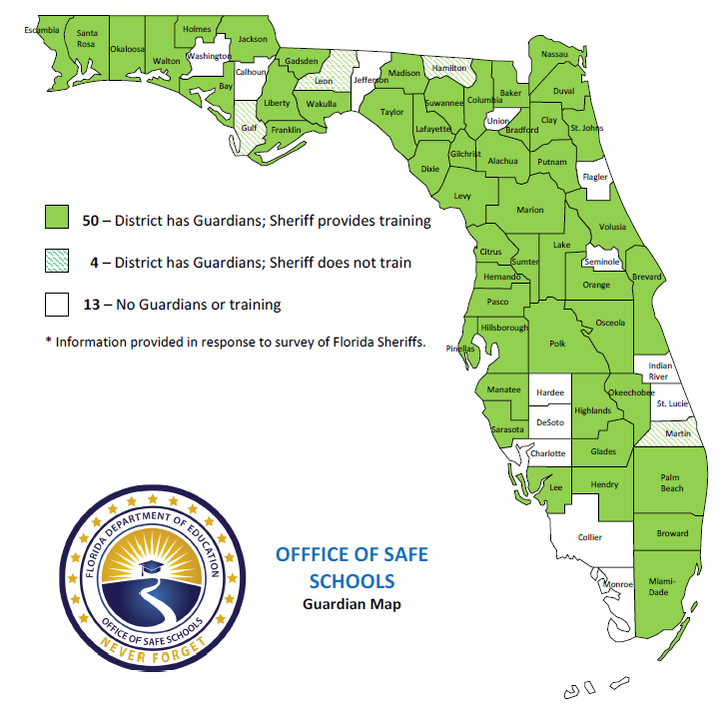
Guardian Programs

Slide 8
Guardian Funding 2018-2025
Fiscal Year | Guardian Funding
2018-19 | $67,500,000
2019-20 | $500,000
2020-21 | $500,000
2021-22 | $6,500,000
2022-23 | $6,500,000
2023-24 | $6,500,000
2024-25 | $6,500,000

