Slide 1
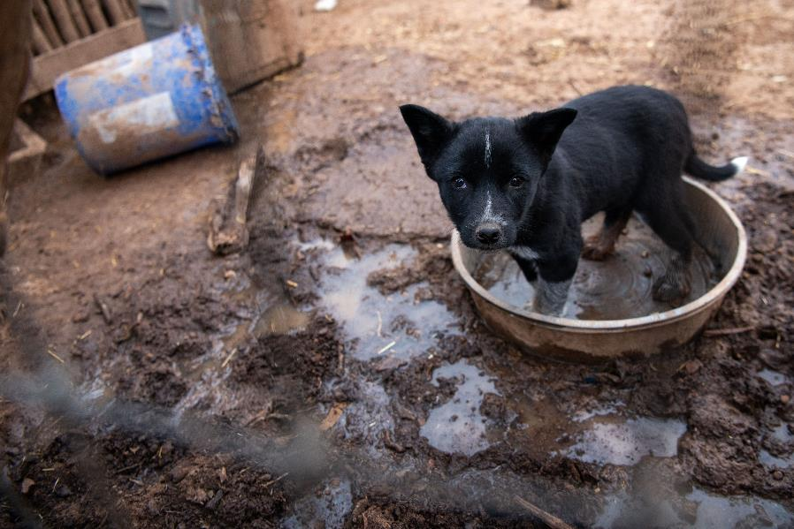
2.1.3. Identify signs of potential misdemeanor or felony neglect of animals
Credit: Meredith Lee/The HSUS

Slide 2
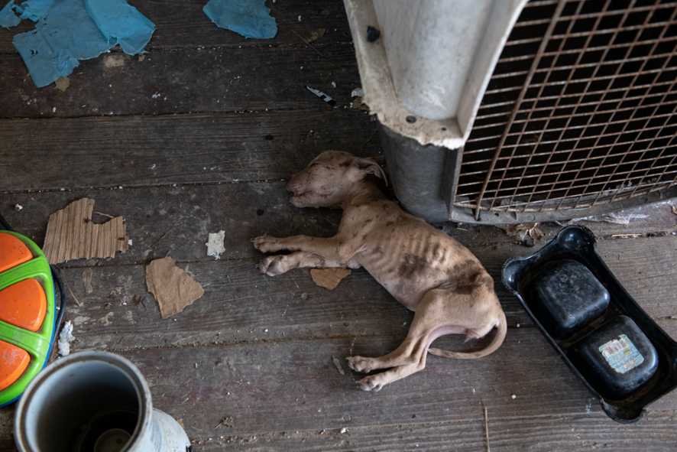
2.1.3. Identify signs of potential misdemeanor or felony neglect of animals
Credit: Meredith Lee/The HSUS

Slide 3
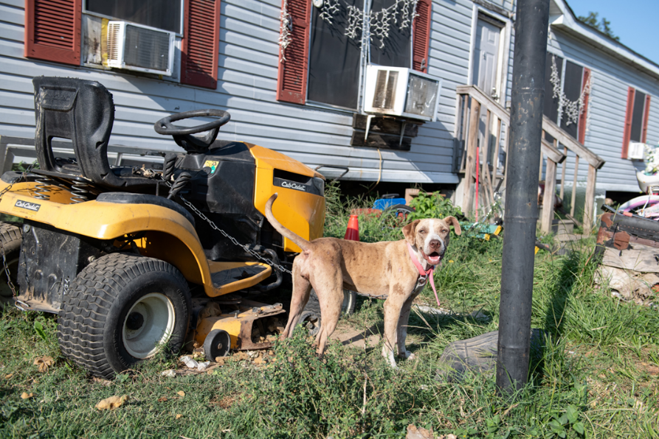
2.1.3. Identify signs of potential misdemeanor or felony neglect of animals
Credit: Meredith Lee/The HSUS

Slide 4
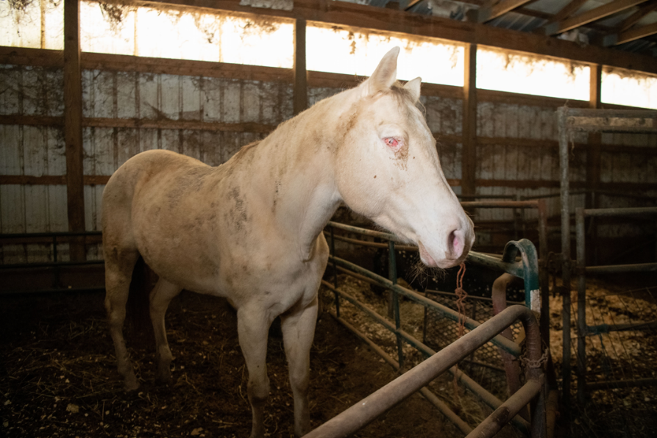
2.1.3. Identify signs of potential misdemeanor or felony neglect of animals
Credit: Meredith Lee/The HSUS

Slide 5
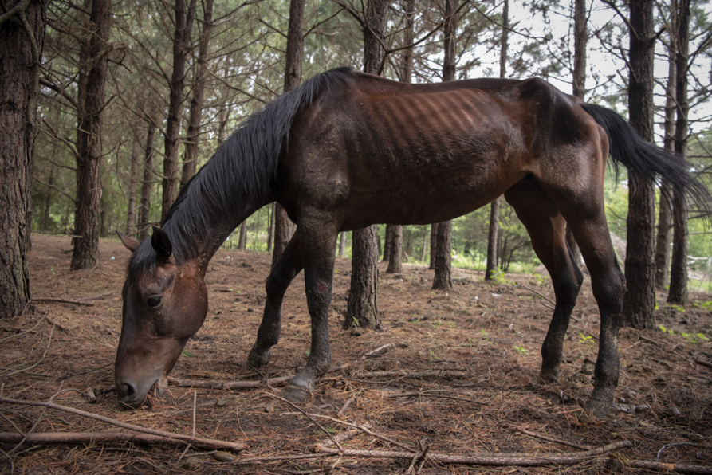
2.1.3. Identify signs of potential misdemeanor or felony neglect of animals
Credit: Meredith Lee/The HSUS

Slide 6
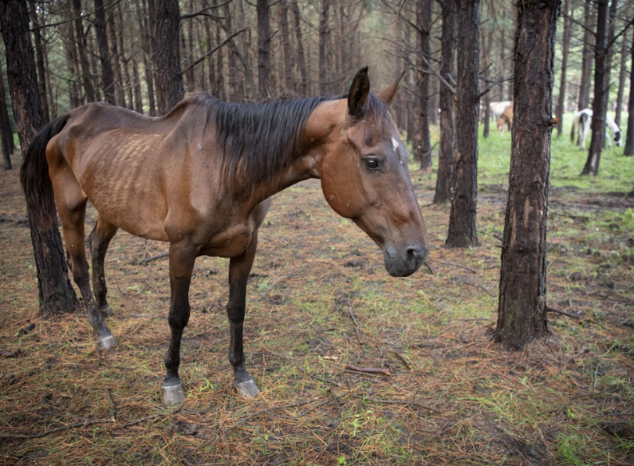
2.1.3. Identify signs of potential misdemeanor or felony neglect of animals
Credit: Meredith Lee/The HSUS

Slide 7
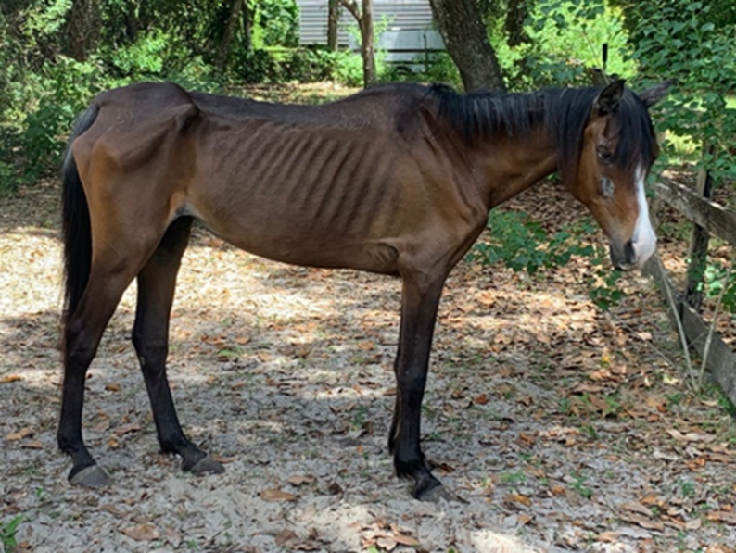
2.1.3. Identify signs of potential misdemeanor or felony neglect of animals
Credit: Polk County Sheriff’s Office

Slide 8
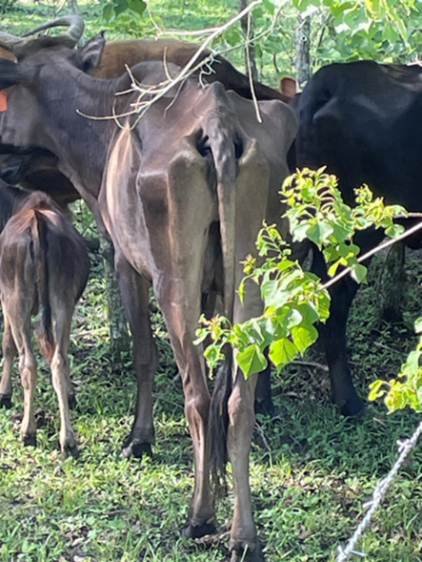
2.1.3. Identify signs of potential misdemeanor or felony neglect of animals
Credit: Polk County Sheriff’s Office

Slide 9
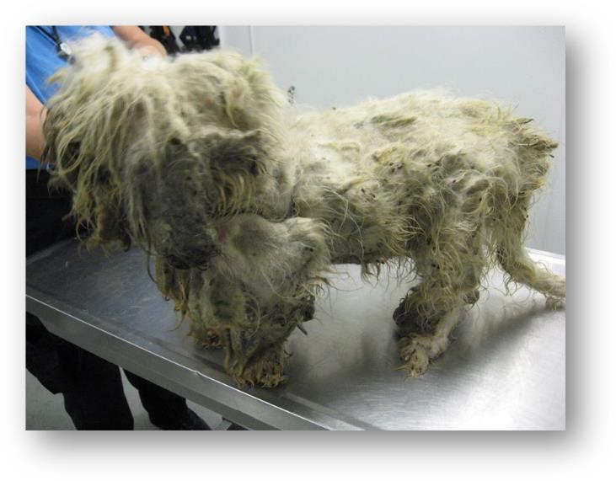
2.1.3. Identify signs of potential misdemeanor or felony neglect of animals
Credit: Adam Leath
Depiction of dog with matted fur.

Slide 10
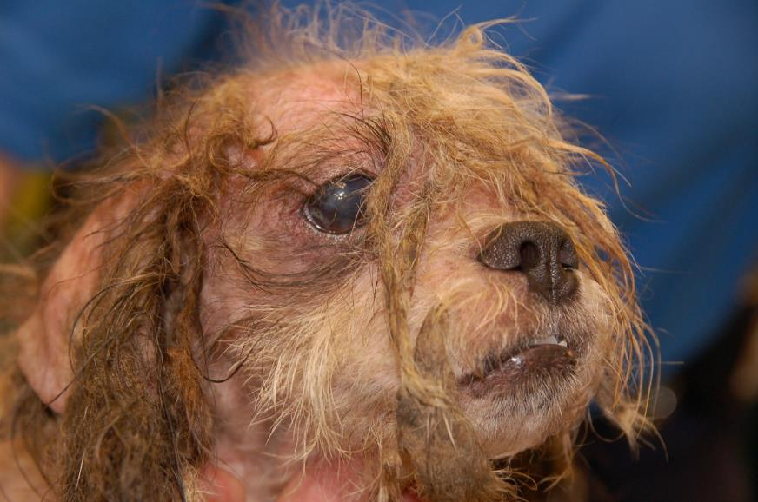
2.1.3. Identify signs of potential misdemeanor or felony neglect of animals
Credit: Adam Leath
Depiction of untreated skin condition.

Slide 11
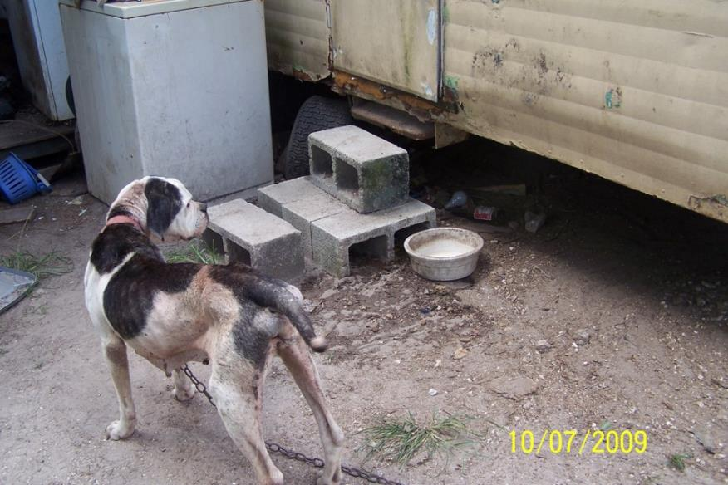
2.1.3. Identify signs of potential misdemeanor or felony neglect of animals
Credit: Adam Leath

Slide 12
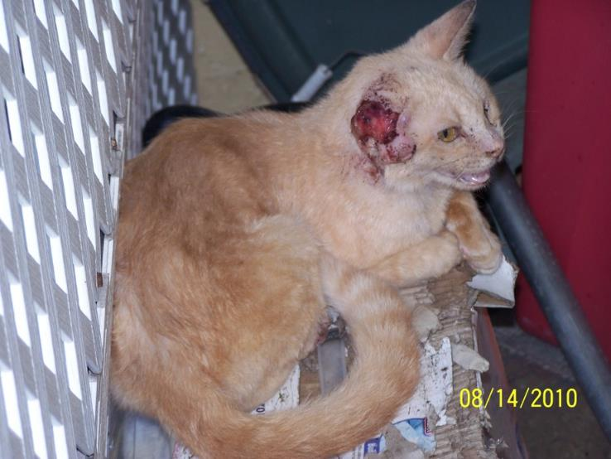
2.1.3. Identify signs of potential misdemeanor or felony neglect of animals
Credit: Adam Leath
Depiction of cat with untreated medical condition.

Slide 13
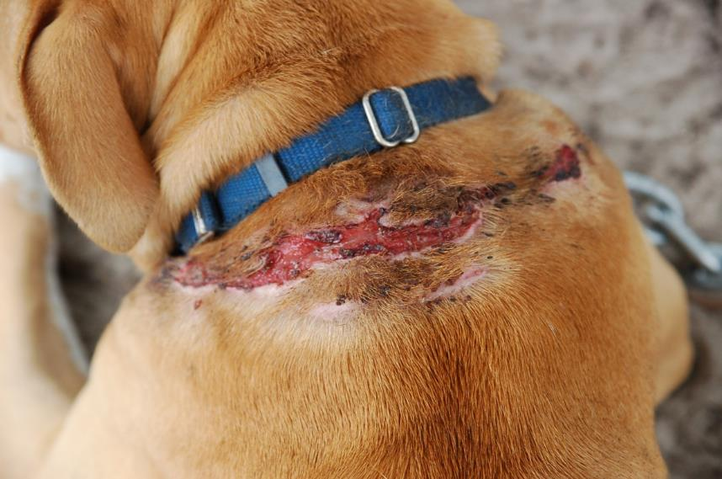
2.1.3. Identify signs of potential misdemeanor or felony neglect of animals
Credit: Adam Leath
Depiction of a wound from an embedded collar.

Slide 14
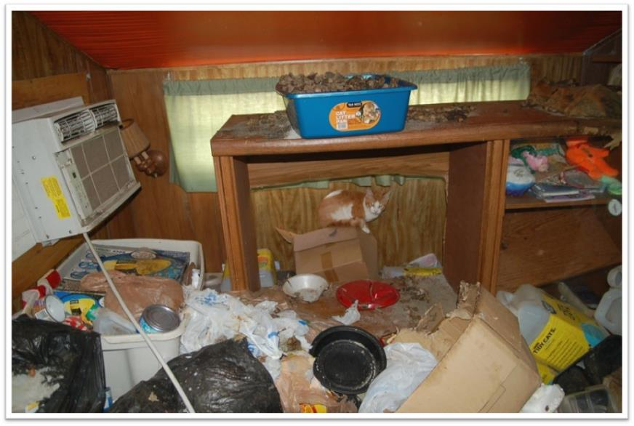
2.1.3. Identify signs of potential misdemeanor or felony neglect of animals
Credit: Adam Leath

Slide 15
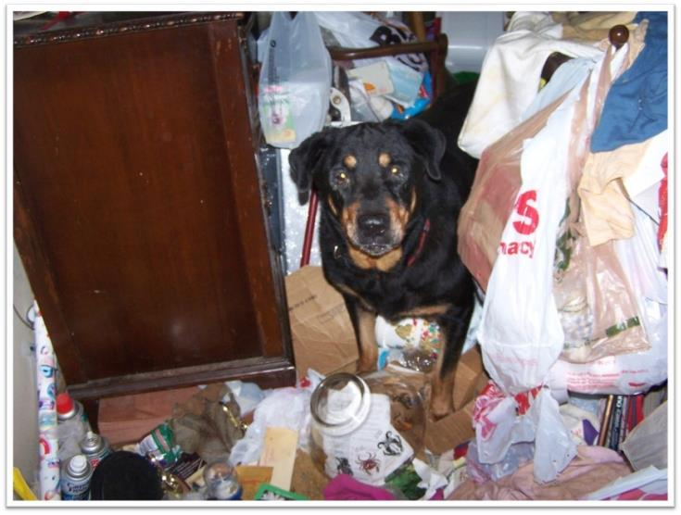
2.1.3. Identify signs of potential misdemeanor or felony neglect of animals
Credit: Adam Leath

Slide 16
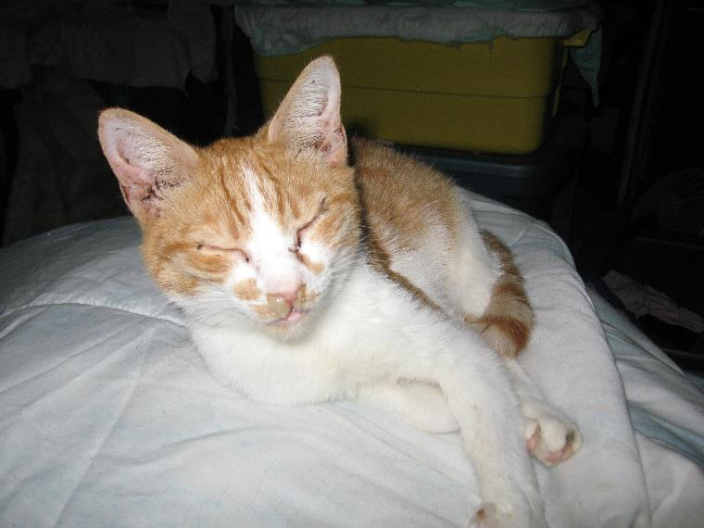
2.1.3. Identify signs of potential misdemeanor or felony neglect of animals
Credit: Adam Leath

Slide 17
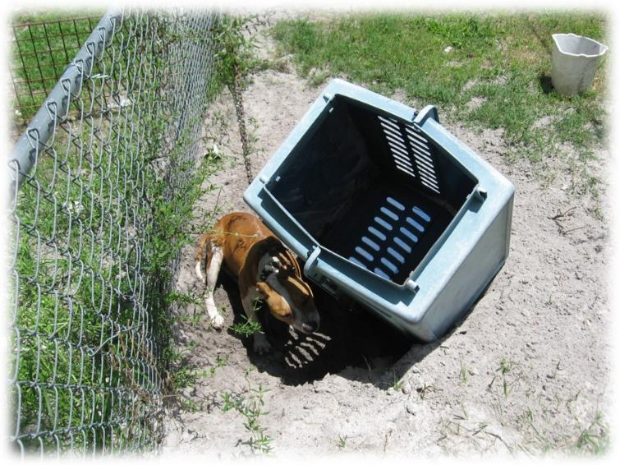
2.1.3. Identify signs of potential misdemeanor or felony neglect of animals
Credit: Adam Leath
Depiction of insufficient shelter.

Slide 18
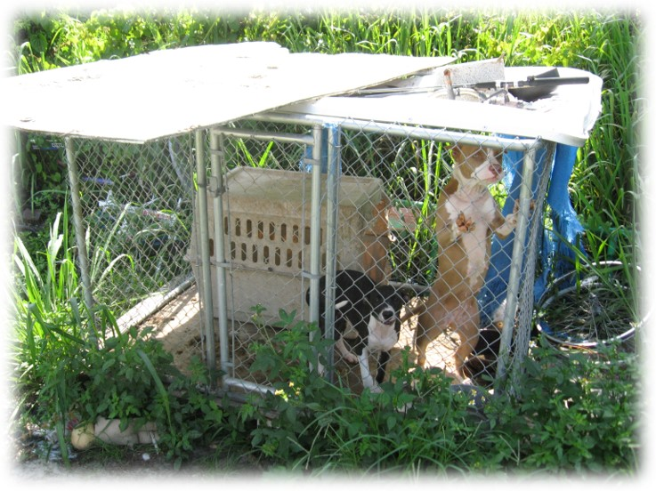
2.1.3. Identify signs of potential misdemeanor or felony neglect of animals
Credit: Adam Leath
Depiction of insufficient shelter.

