Slide 1
House Bill 1473
Marjory Stoneman Douglas High School
Public Safety Commission
July 30, 2024
Darren Norris
Vice Chancellor
Office of Safe Schools

Slide 2
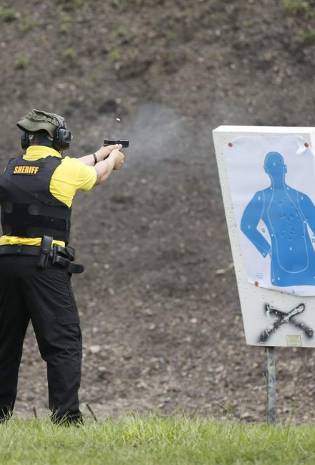
HB 1473 – School Safety: Guardian Program
Section 30.15, Florida Statutes
Former law enforcement officers with current certification may serve as Guardians without completing Guardian training
Florida Department of Law Enforcement (FDLE) will maintain data related to school Guardians
FDOE will provide FDLE records of safe-school officers who have been disciplined, dismissed or that have discharged their firearm

Slide 3
HB 1473 – School Safety: Safe-School Officers
Section 1006.12, Florida Statutes
Agreements between a school board and a law enforcement agency must include the responsibility for maintaining school resource officer training records
Before appointing a school guardian, the district or charter school must contact FDLE and review all relevant information on the guardian candidate

Slide 4
HB 1473 – School Safety: Drones
Section 330.41, Florida Statutes
It is a misdemeanor to knowingly or willfully:
Operate a drone over a public or private PK-12 school, or
Allow a drone to make contact with a school, or any person or object on campus

Slide 5
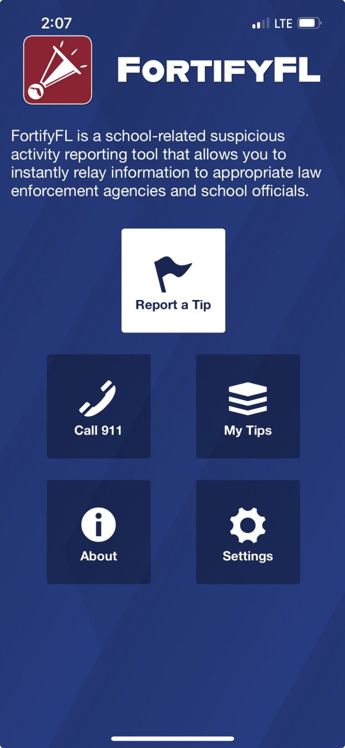
HB 1473 – School Safety: FortifyFL
Section 943.082, Florida Statutes
Each district school board and charter school governing board must ensure that instruction on the use of FortifyFL is provided to students within the first 5 days of each school year - instruction must include consequences for making a threat or false report

Slide 6
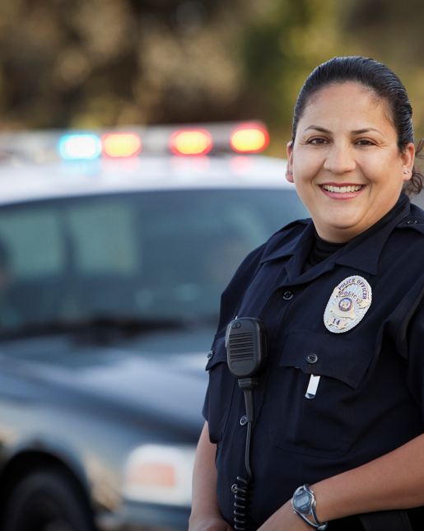
HB 1473 – School Safety: Student in Custody
Section 985.04, Florida Statutes
If a dual enrolled student is taken into custody for certain serious offenses, the superintendent or designee must notify the police chief or safety director of the postsecondary institution within 1 business day

Slide 7
HB 1473 – School Safety: Office of Safe Schools
Section 1001.212, Florida Statutes
By August 1, 2024, OSS must develop and adopt a Florida school safety compliance inspection report, which is completed and adopted in Rule 6A-1.0018, F.A.C.
OSS will conduct triennial, unannounced inspections of all public and public charter schools while school is in session
OSS will investigate reports of noncompliance with school safety requirements

Slide 8
HB 1473 – School Safety: Office of Safe Schools
Section 1001.212, Florida Statutes
OSS has 3 days post-inspection to provide the report to certain district and school staff; recipients have 1 school day to acknowledge receipt
The school safety specialist, charter school administrator or designee has 3 days to provide OSS notice of how noncompliance has been remediated for specific violations of access control and safest area requirements

Slide 9
HB 1473 – School Safety: Office of Safe Schools
Section 1001.212, Florida Statutes
OSS must provide quarterly reports to superintendents and school safety specialists with data on which schools were inspected and which had no school safety requirement deficiencies
Additionally, the school safety specialist must report quarterly to the superintendent and school board on any noncompliance with school safety laws or rules

Slide 10
HB 1473 – School Safety: Office of Safe Schools
Section 1001.212, Florida Statutes
The Office must also refer any staff to the superintendent or charter school administrator for disciplinary action if they knowingly violate the new access control requirements found at s. 1006.07(6)(f), F.S.
Annually, OSS must notify all administrative and instructional personnel via email of new access control requirements

Slide 11
HB 1473 – School Safety: School Board Duties
Section 1006.07, Florida Statutes
New access control requirements:
All gates and other campus access points must remain closed and locked when students are on campus
Exceptions are limited to placing an attendant at an open gate while students are on campus; a shared use agreement pursuant to s. 1013.101,F.S.; or the school safety specialist or designee documenting that the access point is not subject to this requirement based upon other safety measures in place (or, per Rule 6A-1.0018, F.A.C., based on compliance with the Fire Code)

Slide 12
HB 1473 – School Safety: School Board Duties
Section 1006.07, Florida Statutes
New access control requirements:
Doors of school classrooms and other instructional spaces must be locked to prevent ingress when occupied by students, except between classes
If such a door must be left unlocked, the door must be actively staffed

Slide 13
HB 1473 – School Safety: School Board Duties
Section 1006.07, Florida Statutes
New access control requirements:
All campus building access doors, gates and other access points shall remain closed and locked at all times
Exceptions:
people are actively entering or exiting, or
the school safety specialist or designee has documented that the access point is not subject to the requirement based upon other safety measures

Slide 14
HB 1473 – School Safety: School Board Duties
Section 1006.07, Florida Statutes
All instructional spaces must have clearly marked safest areas for student sheltering
Students must be notified of these areas within the first 10 days of the school year
Where marking these areas is not feasible, the school safety specialist or designee must document such, and identify where students must shelter in an emergency

Slide 15
HB 1473 – School Safety: School Board Duties
Section 1006.07, Florida Statutes
Each school must maintain a record that is accessible on each campus or by request of OSS of all current school year and prior school year drills, including the names of law enforcement personnel present on campus for each active assailant emergency drill

Slide 16
HB 1473 – School Safety: School Board Duties
Section 1006.07, Florida Statutes
Each district school board and charter school governing board must adopt a progressive discipline policy for personnel who knowingly violate school safety requirements

Slide 18
Office of Safe Schools Update
Marjory Stoneman Douglas High School
Public Safety Commission
July 30, 2024
Darren Norris
Vice Chancellor
Office of Safe Schools

Slide 19
Office of Safe Schools (OSS) Origins
The Marjory Stoneman Douglas High School Public Safety Act, Chapter 2018-3, Laws of Florida:
Created section 1001.212, Florida Statutes, which launched the Office of Safe Schools, to include:
Florida Safe School Assessment Tool (FSSAT)
Training and technical assistance for school district personnel
School Safety Specialist training program
Safe Schools data portal
Hardening grants
FortifyFL education
Allocated funding for 3 full-time staff

Slide 20
Office of Safe Schools (OSS) Staffing 2018-19
Executive Director
Program Oversight
Support Staff
General Inquiries
Correspondence
Scheduling
Deputy Director
Guardian Grants
Bullying Prevention
Threat Assessment
Program Lead
FortifyFL
School Safety Specialist Liaison
Incident & Discipline Data (SESIR)
Program Lead
Florida Safe Schools Assessment Tool (FSSAT)

Slide 21
OSS Staffing – 2018 to Present

Slide 22
Office of Safe Schools (OSS) Staffing 2024
Vice Chancellor
Support Staff
1 Staff Position
Executive Director
Deputy Director
Deputy Director
Deputy Director
Grants & Contracts
7 Staff Positions
Compliance
14 Staff Positions
Threat Management
1 Staff Positions
Data Analytics
3 Staff Positions
Support Staff
1 Staff Position
Training
5 Staff Positions
37 Total Positions

Slide 23
Office of Safe Schools – Threat Management & Training
Deputy Director
Training/Comms Director
Threat Management Trainer
Compliance/Trainer
Compliance/Trainer
Compliance/Trainer
Trainer

Slide 24
Office of Safe Schools – Compliance
Deputy Director
Support Staff
Statewide Compliance Director
North Region Lead
Central Region Lead
South Region Lead
Compliance
Compliance
Compliance
Compliance
Compliance
Compliance
Compliance
Compliance
Compliance
Compliance

Slide 25
Office of Safe Schools – Contracts, Grants & Data Analytics
Deputy Director
Grants & Contracts Director
Data Analytics Director
Grants (Hardening)
Data (District Support)
Grants (Jewish Day Schools)
Data (Reporting)
Grants (Canine & DTMC)
Grants (Guardians)
Grants (Special Programs*)
Contracts (Alyssa’s Alert & FSSAT)
*School Safety Specialist training, bleeding control kits, local projects

Slide 27
Emergency Drills
Marjory Stoneman Douglas High School
Public Safety Commission
July 30, 2024
Darren Norris
Vice Chancellor
Office of Safe Schools

Slide 28
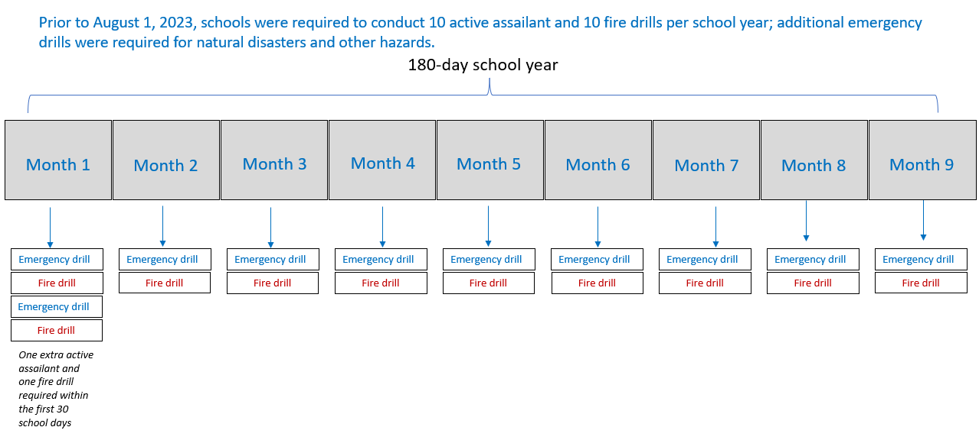
Emergency Drills Prior to August 2023
The 2022 Legislature (House Bill 1421) required the Department to adopt rules applicable to emergency drills. Rule requirements went into effect on August 1, 2023.

Slide 29
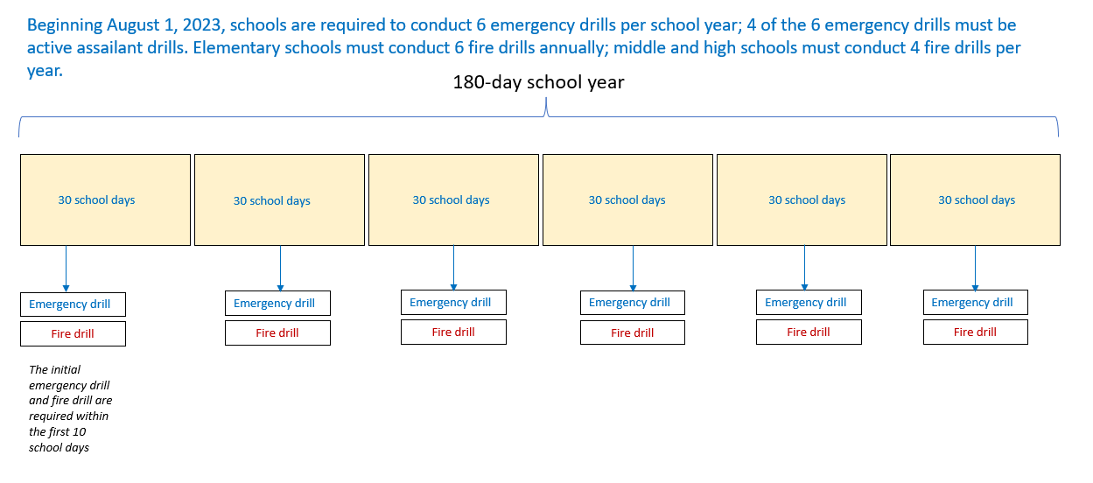
Emergency Drills Since August 2023
In 2023, changes were also made to the Florida Fire Prevention Code to reflect new fire drill requirements.

Slide 31
Office of Safe Schools Compliance Inspection Program Updates
Marjory Stoneman Douglas High School
Public Safety Commission
July 30, 2024
Jonathan Stephens
Deputy Director
Office of Safe Schools

Slide 32
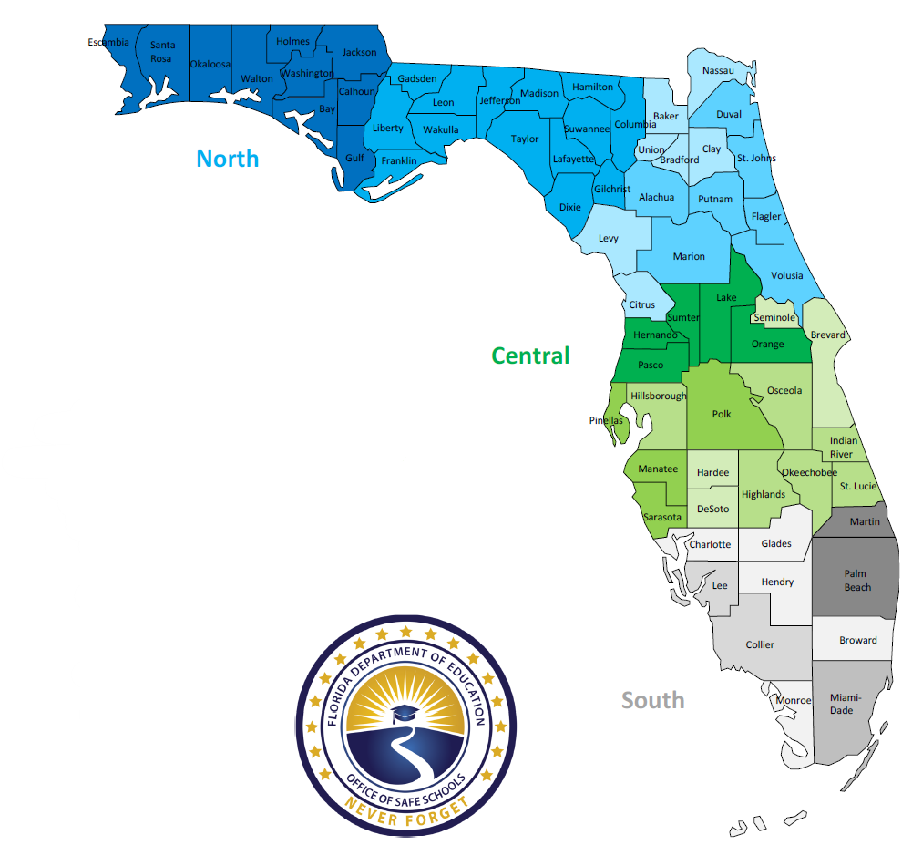
OSS Compliance Regions
1 Director of Compliance
North: 931 Schools
1 Regional Lead
3 Compliance Specialist
Central: 1,499 Schools
1 Regional Lead
4 Compliance Specialist
South: 1,273 Schools
1 Regional Lead
3 Compliance Specialist

Slide 33
Office of Safe Schools Compliance
4,546 compliance monitoring visits have been conducted to date
1,646 compliance monitoring visits were conducted during the 2023-24 SY
Every school visited at least once as of the end of the 2023-24 SY
Schools were inspected on 28 school safety measures, which included rule and statutory requirements in addition to best practices

Slide 34
Analysis of Compliance Monitoring Visits
52% of schools inspected by OSS during the 2023-24 SY had no compliance deficiencies observed
The most common compliance deficiencies encountered were:
Requested documentation not provided at time of visit (22%)
After action reports not completed as required (11%)
When adjusted for documentation and administrative deficiencies, the compliance rate increases to 67%

Slide 35
Analysis of Compliance Monitoring Visits
Physical/operational security measures vs. documentation deficiencies
Of the compliance deficiencies observed, over 40% were administrative in nature (i.e., documentation not available)
Requested documentation not provided at time of visit (22%)
After action reports not completed as required (11%)
Threat Assessment Team meeting documentation not complete (7%)

Slide 36
Analysis of Compliance Monitoring Visits
Increased emphasis in 2023-24 SY on checking for unlocked classroom doors
Unlocked classroom doors accounted for 11% of all best practice deficiencies observed
5% decrease from previous year
HB 1473 makes this a requirement for schools

Slide 37
New Compliance Inspection Requirements for OSS
OSS shall conduct unannounced inspections of all public and charter schools:
while in session, and
triennially (once every 3 years)
OSS shall reinspect any school with documented deficiencies within 6 months

Slide 38
New Compliance Inspection Requirement for School Districts
School Safety Specialist, or designee, must conduct unannounced inspections at least annually of all public and charter schools within the district
Must be while school is in session
Must be documented on the District Safety Compliance Inspection Report within Florida Safe Schools Assessment Tool (FSSAT)

Slide 39
District Safety Compliance Inspection Report
Based on same compliance inspection report used by OSS during compliance monitoring visits
Released to districts June 1, 2024
Covers school safety measures that range from rule and statutory based physical security measures to administrative and operational procedures.
Includes best practices for consideration

Slide 41
Alyssa’s Alert Update
Marjory Stoneman Douglas High School
Public Safety Commission
July 30, 2024
Darren Norris
Vice Chancellor
Office of Safe Schools

Slide 42
Safe Schools Funding – Alyssa’s Alert
Passage of Alyssa’s Law in 2020 required mobile panic alert systems in schools
The Alyssa’s Alert program budget is based on an allocation of $2,000 per school (traditional and charter)
Alyssa’s Alert annual, recurring statewide allocation is $6.4 million

Slide 43
Vendor Information
In 2021, 9 vendors were selected from the original procurement
Immediately, 2 vendors opted out of participating
In 2024, 1 vendor was removed due to lack of 911 connectivity
Also in 2024, 1 vendor failed to renew contract properly
As of July 2024, 5 vendors remain to provide services

Slide 44
Utilization of Products
Cellular phone applications; download issues
Many have laptop or PC based applications
Worn devices / Lanyards
Overall, use remains high as evidenced through compliance inspections

Slide 46
Overview of School Safety Funding
Marjory Stoneman Douglas High School
Public Safety Commission
July 30, 2024
Darren Norris
Vice Chancellor
Office of Safe Schools

Slide 47
Safe Schools Funding – Safe Schools Allocation
The Safe School Allocation (SSA) had fluctuated between $50 million and $75 million from 1994 to 2017. In 2018, the SSA was nearly $162 million; 2024-25 SSA is $290 million.

Slide 48
Safe Schools Funding – Projects
Training (School Safety Specialists & training management system) – $500,000 annually
Chris Hixon, Coach Aaron Feis, and Coach Scott Beigel Guardian Program – $6.5 million annually
Hardening Grant – $42 million annually
Bleeding Control Kits – $1.25 million
District Threat Management Coordinators – $5 million annually

Slide 49
Safe Schools Funding – Other Projects
Florida Safe Schools Canine Program – extension of unspent 2023 funds, plus $3.3 million annually
Data Portals & Infrastructure
FSSAT – $845,000 annually (with some fluctuation)
Safety Portal – $3 million annually
Threat Management Portal – $17 million to date
SESIR Portal – $4.5 million to date

