Slide 1
Florida’s Harm Prevention and Threat Management Model
July 30, 2024

Slide 2
SCHOOL SAFETY
is everyone’s responsibility, and it must be the number one priority in Florida’s schools.

Slide 3
2018
2019
2020-2021
2022
2023
s. 1006.07(7), F.S.
Required establishment of multidisciplinary threat assessment teams at every school.
s. 1001.212(12), F.S.
Required a standardized, statewide behavioral threat assessment instrument for use by all public schools, including charter schools.
Continued implementation and monitoring of the former model for behavioral threat assessment.
Office of Safe Schools identified deficiencies in the former model.
s. 1006.07(7)(a), F.S.
Required all members of the threat assessment team to be involved in the threat assessment process and final decision making.
MSD Commission formed a Threat Management Workgroup to address identified issues.
HB 543
Required the Office of Safe Schools to develop a statewide behavioral threat management instrument and statewide behavioral threat management process.

Slide 4
FL Model Distinctions
Every district must now have a District Threat Management Team, to include a designated District Threat Management Coordinator.
A staff member with personal knowledge of the student must participate with the School Based Threat Management Team.
Early summary disposition of cases by the Chair for cases that should not go to the full School Based Threat Management Team.
Required timeframes to complete required tasks, from intake to monitoring periods.
Shift from “threat assessment” to “threat management” by utilizing Student Support Management Plans.
Two tiered review and approval for any threat management action taken by the School Based Threat Management Team.
Florida specific Threat Management Manual and Instrument to ensure proper documentation and decision making.

Slide 5
Acronyms: Florida Threat Management Manual
DTMC – District Threat Management Coordinator
DTMT – District Threat Management Team
SBTMT – School Based Threat Management Team
SSMP – Student Support Management Plan

Slide 6
DTMT and SBTMT Roles
Florida’s Harm Prevention and
Threat Management Manual

Slide 7
DTMT Roles
DTMC – Team Lead
School District Administrator
Expertise in Counseling
School Instruction Experience
Law Enforcement Officer
DTMT supports both traditional and charter public schools.

Slide 8
DTMC Roles and Responsibilities
Responsible for ensuring the fidelity of the district’s threat management program.
Second tier of review in the threat management process.
Responsible for ensuring that all SBTMT and DTMT members are appropriately trained.
Districts are eligible to receive funding for the DTMC position in July 2024.

Slide 9
SBTMT Roles
Members Include:
School Administrator (must NOT be the Principal)
Expertise in Counseling: Certified School Psychologist, Certified School Social Worker, Certified School Counselor or Licensed Mental Health Professional
Expertise in School Instruction: meets the definition of instructional personnel under s. 1012.01(2)(a)-(d), F.S., or holds a current Florida Educator Certificate
Certified Law Enforcement Officer (guardians do not qualify)

Slide 10
SBTMT Role Clarification
Individual with personal knowledge of student being assessed can be a sitting member of the team.
If the person is not a core team member and is there to provide background knowledge, they are not required to be trained and they are not a decision-making member. This staff member must be an instructional or administrative employee.

Slide 11
SBTMT Chair and Vice-Chair Roles and Responsibilities
Chair is the point person at each school re: threat management.
Vice-Chair performs duties of Chair when Chair is absent.
All reports of threats and concerning behavior are reported to Chair.
Chair assesses each report for factual basis and merit.
Chair can summarily close report, or refer to entire SBTMT (Principal and DTMC review).

Slide 12
Principal Roles and Responsibilities
Review all SBTMT final decisions and recommendations to ensure completeness and fidelity, and the Principal will determine whether he/she concurs with the team’s decisions.
The Principal is the first tier of review in the threat management process.

Slide 13
Training Requirements
Any SBTMT or DTMT member must complete Day 1 training in person.
Any Principal, SBTMT Chair or SBTMT Vice-Chair must complete Day 1 training, followed by an additional 4 hours of training in person, specific to their role.
Any DTMC must complete Day 1 training, followed by an additional 8 hours of training in person, specific to their role.
Additionally, the SBTMT and DTMT are required to participate in mandatory annual retraining to be completed within the first sixty (60) days of school.

Slide 14
Florida Model Training Numbers
Day 1 Florida Model Training: 29,146
Principal/Chair/Vice Chair Florida Model Training: 13,402
*As of 6/24/24

Slide 15
DTMCs & Trainers
DTMC & Trainer: 89
DTMC Only: 33
Trainer Only: 128
Total: 250
*As of 6/24/24

Slide 16
The Basics

Slide 17
Threat
Concerning Behavior
Communication or behavior indicating that an individual poses a danger to the safety of school staff or students through acts of violence, or behavior that would cause harm to self or others.
Includes communication or behavior characteristic of a person who is on the pathway to violence, and may be expressed/ communicated behaviorally, orally, visually, in writing, electronically or through any other means.
A threat is not a communication or behavior that is an obvious joke or unequivocally known by the observer to be innocuous.
An observable behavior that elicits concern in others regarding the safety of an individual or those around them.
May be prohibited behavior, but also might be other behaviors that elicit concern.
Does not necessarily imply or predict that an individual or group will become violent.
Serves as an indicator that the student may need intervention or increased supports to prevent the situation from progressing.

Slide 18
Consider the totality of concerning behaviors, stressors and protective factors to determine if and where the student is on the pathway to violence and the level of concern.

Slide 19
Levels of Concern

Slide 20
Possible Levels of Concern
Unfounded
Low
Medium
High

Slide 21
Unfounded Determination
No sufficient factual basis,
A threat was never made,
What was said was clearly not a threat, OR
Concern did not happen or pose a threat of harm to the school.

Slide 22
Low Level of Concern
A threat or concern is minimal.
Underlying issues can be resolved easily.
Student has significant protective factors, and the ability to cope with any existing stressors.
Student has a desire to resolve any personal grievance rather than escalating on the pathway to violence.

Slide 23
Medium Level of Concern
Does not pose an imminent threat, but has potential intent to harm that requires intervention.
Lacks significant protective factors.
Exhibits other concerning behaviors or stressors that require intervention.
Person may not have made a decision about whether to act violently (e.g., “I don’t want to hurt them, but no one is helping me.”).

Slide 24
High Level of Concern
Poses a potentially imminent threat of violence.
Exhibits behaviors that indicate both a continuing intent to harm and an effort to acquire the capacity to carry out a plan.
Exhibits other concerning behavior that requires immediate intervention.
Need protective measures for the target(s).

Slide 25
Student Support Management Plan (SSMP)

Slide 26
What is an SSMP?
It is a Student Support Management Plan that uses direct and indirect interventions to help create an environment less likely to produce violence.

Slide 27
Monitoring SSMP
Minimum time periods for SSMP implementation and monitoring:
Low Level - 90 days minimum
Medium Level - 180 days minimum
High Level - one year minimum
No downgrading level of concern from initial determination of level of concern.
SSMP can be extended beyond the minimum time frame based on need.
At least 30 days before the end of the initial SSMP monitoring period for each threat level, the SBTMT shall consider the matter again and assess whether to close the case upon expiration of the monitoring period or extend the SSMP.

Slide 28
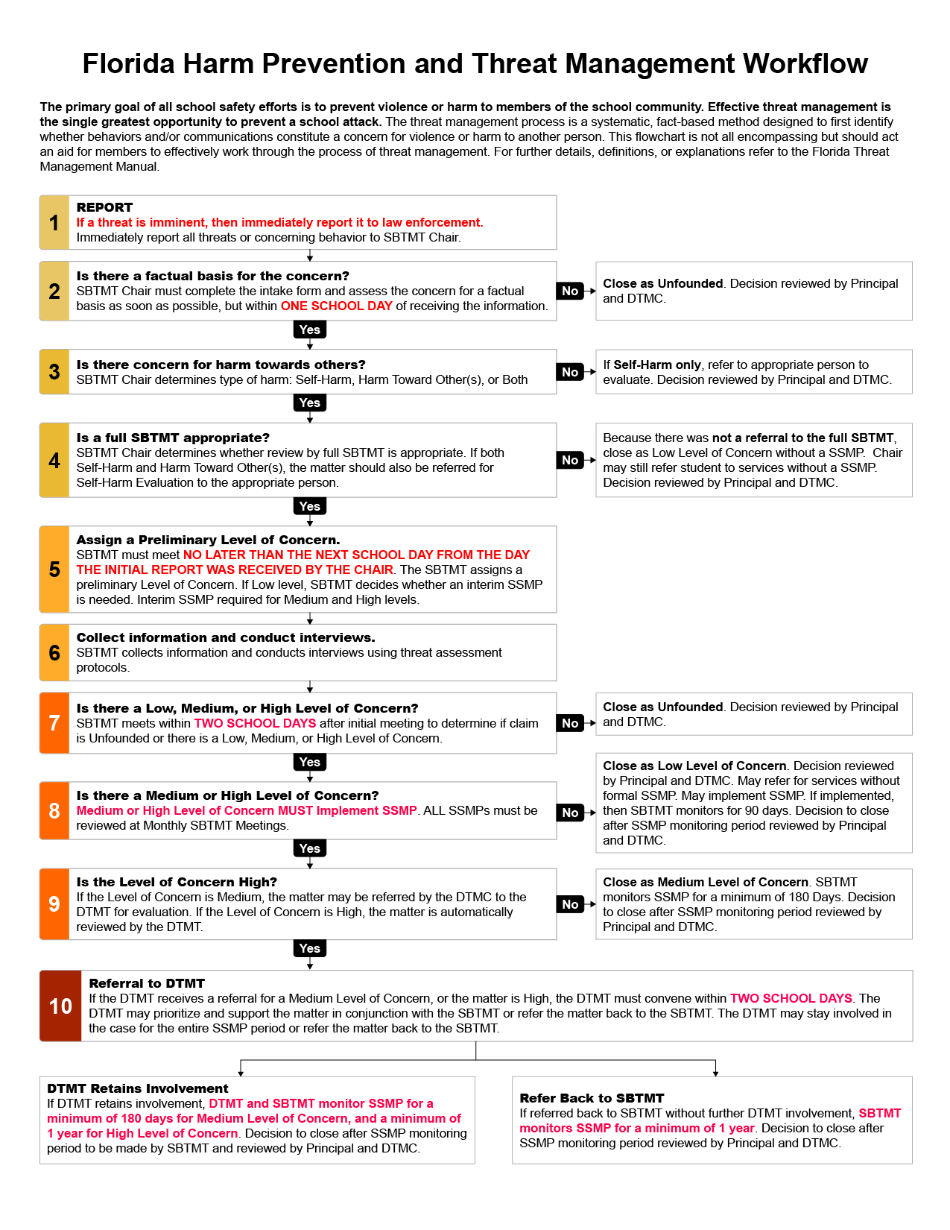
Standardized Threat Management Operational Process

Slide 29
Data

Slide 30
Questions?

