Slide 1
PINELLAS COUNTY SHERIFF’S OFFICE
PINELLAS COUNTY FAMILY REUNIFICATION TASKFORCE (FRC)

Slide 2
OVERVIEW OF THE FRTF
The purpose is to coordinate a multi-agency approach to quickly respond to a mass casualty event and establish a reunification area.
It requires assigned taskforce members to establish and monitor each pre-identified area of the process.
The expectation is to collaboratively problem solve within each assigned area to provide resources or communication for the reunification of affected subjects with their families.
PINELLAS COUNTY SHERIFF’S OFFICE

Slide 3
GOALS & OBJECTIVES OF A FAMILY REUINIFICATION CENTER
Reuniting family members after a tragic event
Provide a safe secure location to gather for the purpose of family reunification
Provide basic needs such as water, food, or other necessities
Provide medical and counseling services or resources
Collect evidence and witness statements
Obtain pertinent information on missing persons
PINELLAS COUNTY SHERIFF’S OFFICE

Slide 4
MASS CASUALTY INCIDENT (MCI)
Any occurrence or threat, whether by natural causes, accident, or intentional act, that results or may result in a substantial injury or harm to people, or substantial damage to or loss of property. A characteristic of an MCI is emergency services being overwhelmed by the number, or injury severity, of affected persons.
PINELLAS COUNTY SHERIFF’S OFFICE

Slide 5
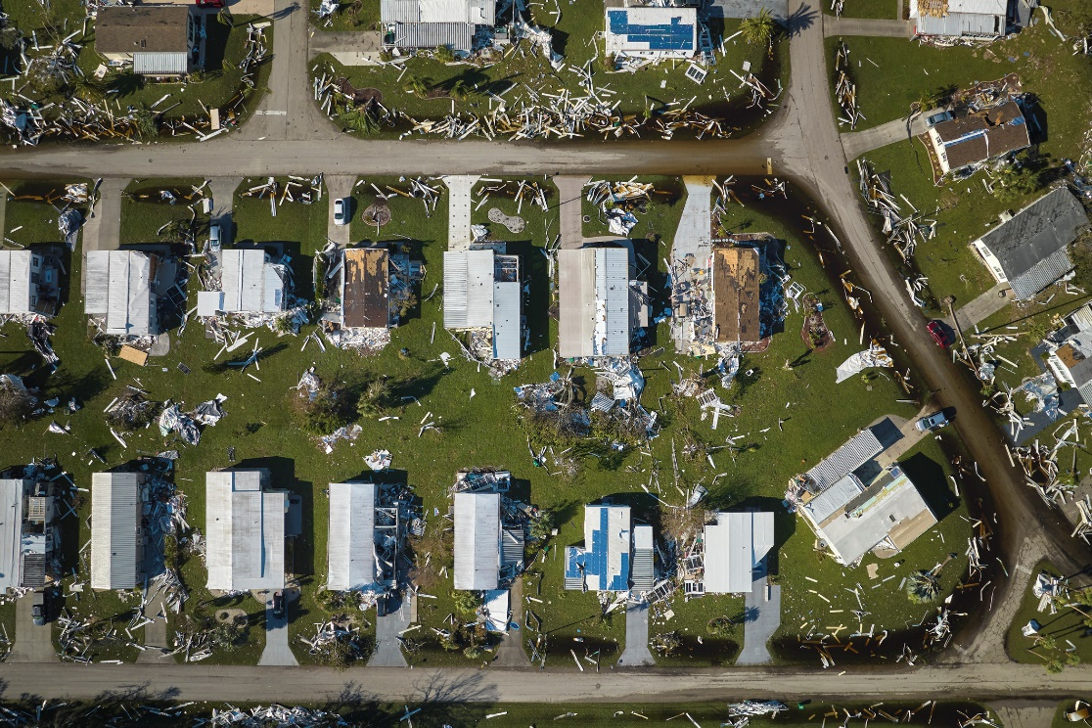
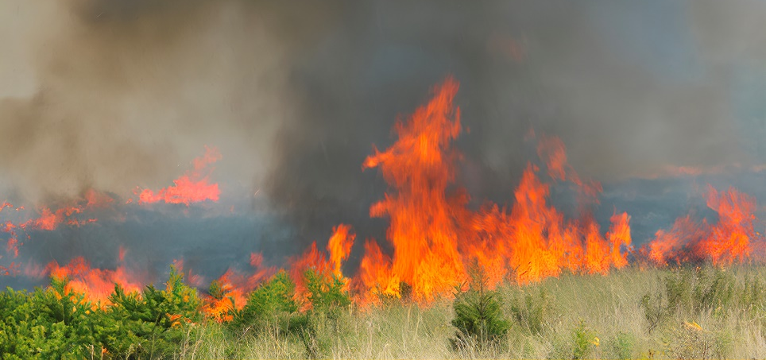
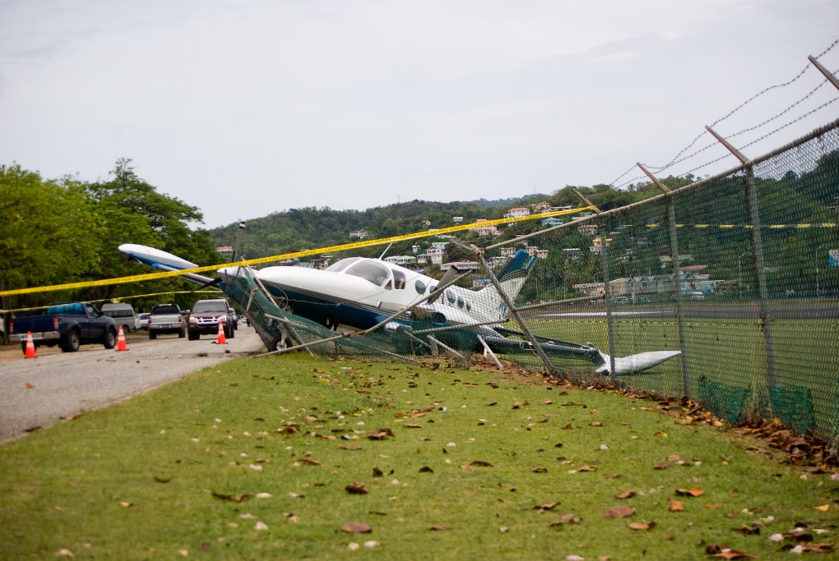
NOT JUST FOR SCHOOL SHOOTINGS
PINELLAS COUNTY SHERIFF’S OFFICE

Slide 6
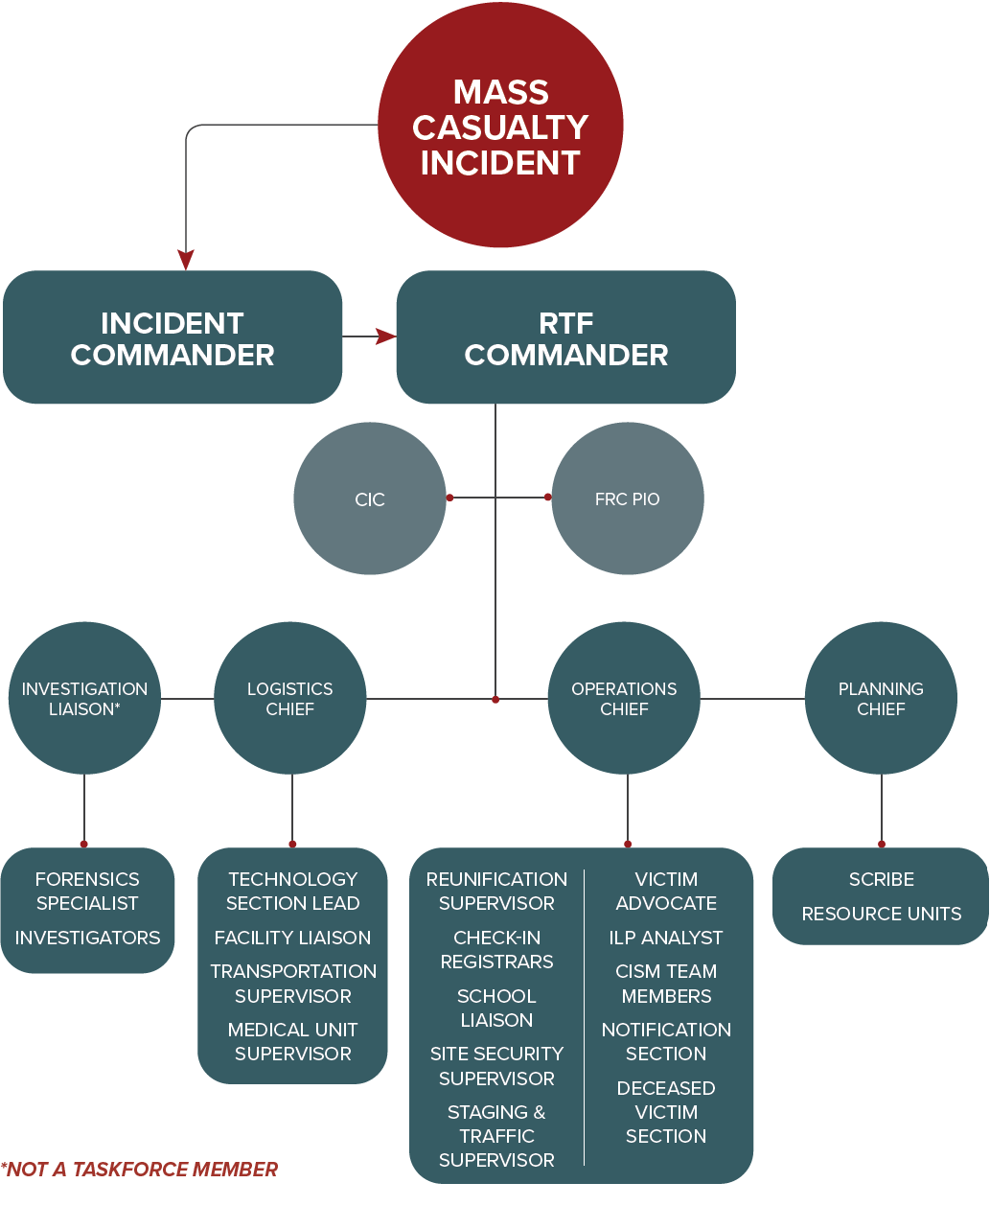
FRC OPERATIONAL STRUCTURE
PINELLAS COUNTY SHERIFF’S OFFICE

Slide 7
MULTIPLE AGENCIES COMPRISE TASKFORCE
There are a total of 300 taskforce members comprised of the Pinellas County Sheriff’s Office, 10 municipal police departments, one university police department, and Pinellas County Fire/EMS.
52 Taskforce Supervisors
50 RAPTOR Trained Members
50 School Bus Drivers
17 County Information Center Members
Other resources involved include:
Fire/EMS from other agencies
Emergency Management
Victim Advocates and Social Workers
Clergy and Chaplains
Pinellas County School Board
PINELLAS COUNTY SHERIFF’S OFFICE

Slide 8
SELECTION OF TASKFORCE MEMBERS
Each participating agency selects personnel for assignment to the taskforce.
Members are a combination of sworn and non-sworn personnel.
Members attend training at least twice per year after their initial training.
PINELLAS COUNTY SHERIFF’S OFFICE

Slide 9
TASKFORCE MEMBER NOTIFICATION PROCESS
Depending on the agency, members will be notified by their agency point of contact or supervisor and/or by an automated callout system. The staging location will be provided.
Immediate response will be requested for all available taskforce members. A relief shift will be scheduled if needed.
Once the size of the response is determined, the commander will regulate staffing and relief.
PINELLAS COUNTY SHERIFF’S OFFICE

Slide 10
EXPECTATIONS
Appropriately address affected persons and their families that will be under stress and displaying a wide range of emotions.
Coordination will occur among taskforce members to ensure each subject is moving through the process.
Problem-solve and communicate needs within designated posts to their assigned supervisors.
Conduct the duties of assigned posts to ensure a smooth flow.
Adapt to any challenges as they arise.
PINELLAS COUNTY SHERIFF’S OFFICE

Slide 11
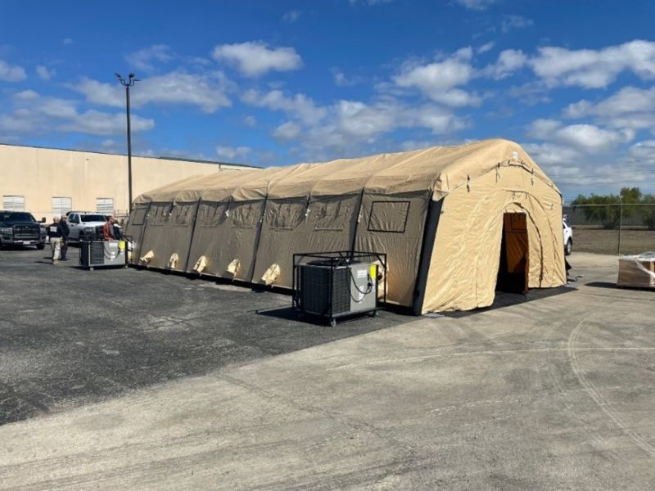
LOCATION
Close to the MCI, but not visible to the MCI
Tent shelters will be utilized
May also require a building or combination of tents and buildings
The location will be identified by the commander upon activation
PINELLAS COUNTY SHERIFF’S OFFICE

Slide 12
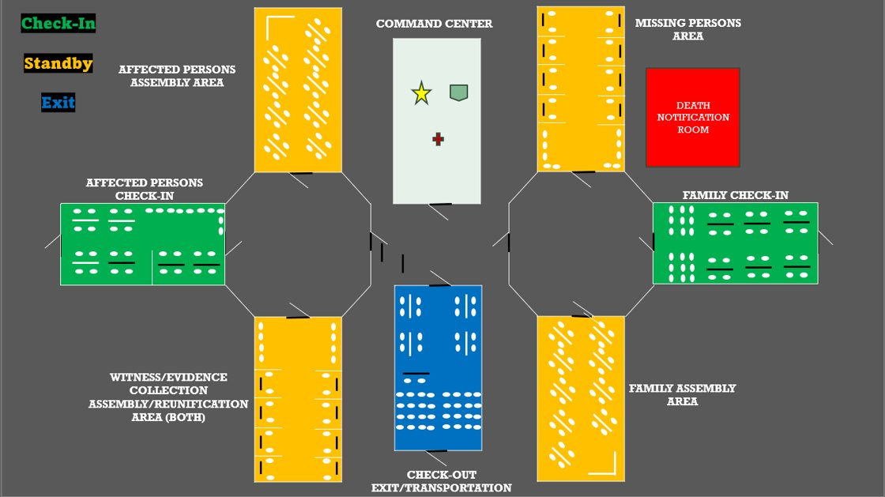
ENTRY AREAS (CHECK-IN)
PINELLAS COUNTY SHERIFF’S OFFICE

Slide 13
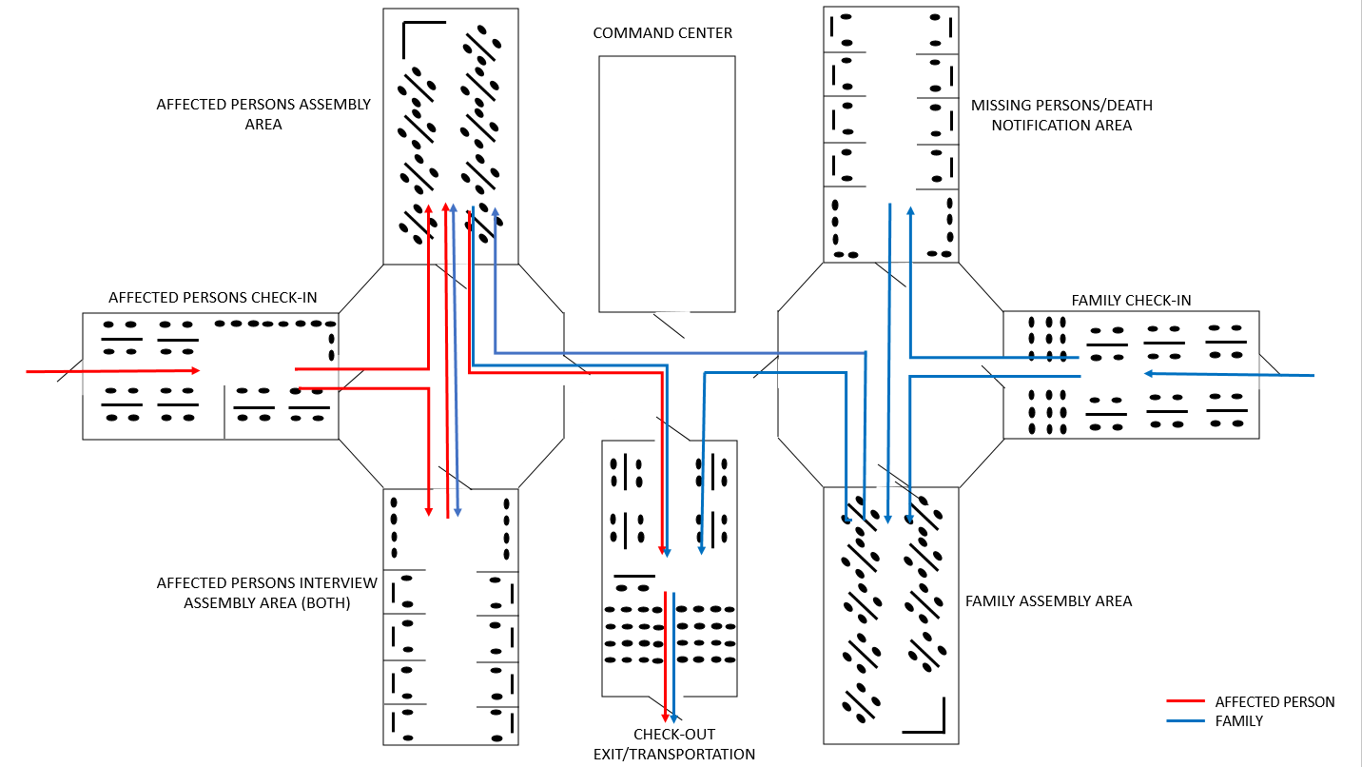
ILLUSTRATION OF FLOW
PINELLAS COUNTY SHERIFF’S OFFICE

Slide 14
ADDITIONAL SECTIONS & RESOURCES
The Technology Section will provide continual IT assistance for set-up, radio communication, and any other technological issues that arise while the FRC is in operation.
The Identification and Notification Section is made up of investigative services including law enforcement analysts to collect and distribute data.
The Site Security Section is comprised of uniformed security inside and outside of the FRC, all traffic surrounding the facility, and traffic in and out of the FRC. Family members will have a separate traffic flow to the family entrance, not viewable by the affected person entrance. Two-way traffic must be maintained in and out of the FRC to allow for the entry and exit of emergency vehicles.
PINELLAS COUNTY SHERIFF’S OFFICE

Slide 15
ADDITIONAL SECTIONS & RESOURCES (CONT’D)
The Medical Unit Section is comprised of EMS in an assigned medical area on the premises to address minor medical needs due to the reactions to stress, grief, or emotional trauma.
The Resource Section personnel will assist in mobilizing resources and equipment to and from the FRC.
The County Information Center is a call center staffed by communications center dispatchers and county employees. The CIC will be responsible for providing information about the mass casualty incident and the FRC to the public. Staff will operate hotlines, obtain information, provide reunification information, and the FRC location to family members.
Bus drivers will be taskforce members identified to facilitate the transportation of subjects utilizing Pinellas County school busses.
PINELLAS COUNTY SHERIFF’S OFFICE

Slide 16
TERMINOLOGY
Affected Persons: any person involved in the mass casualty event including witnesses, persons uninjured, persons injured, and deceased persons.
Greeters: personnel assigned to directing subjects to registration and answering basic questions.
Registrars: personnel responsible for obtaining required information from affected persons and family members and entering it into the reunification software. Will ask pre-determined questions to identify witnesses or evidence that needs to be collected.
Runners: personnel assigned to move affected persons and family members through the pre-established areas.
FRC Supervisors: taskforce members appointed to oversee various FRC functions.
PINELLAS COUNTY SHERIFF’S OFFICE

Slide 17
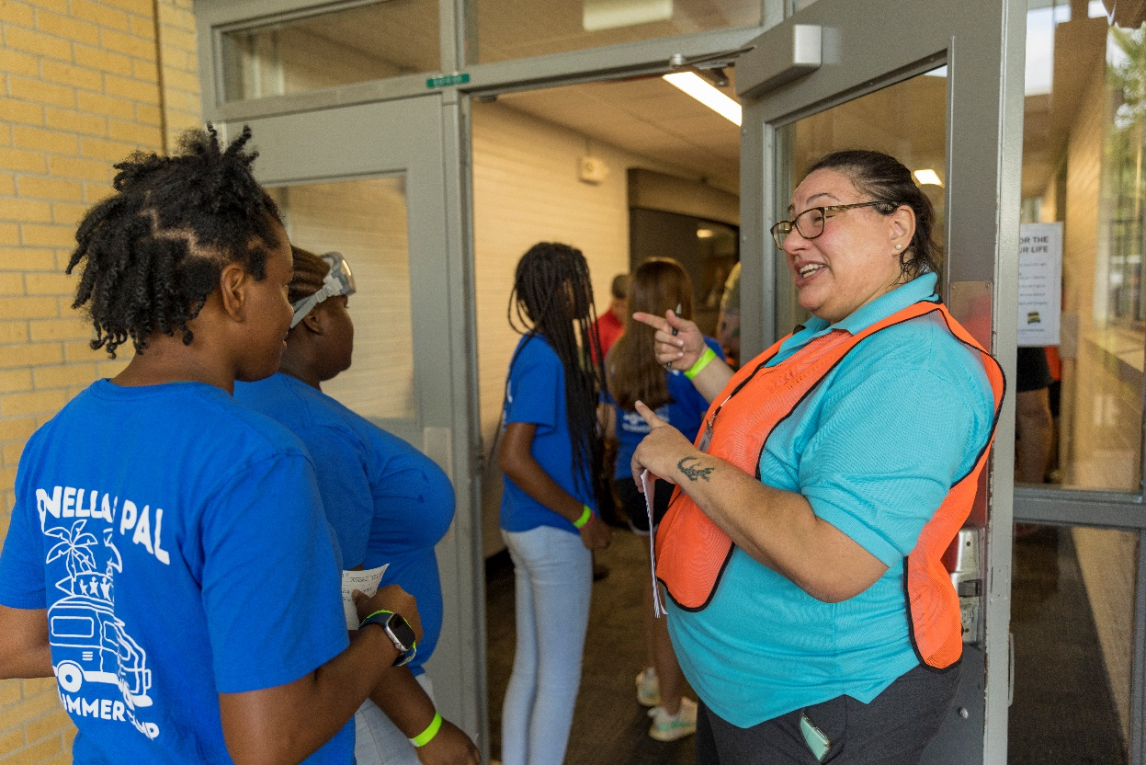
ENTRY/CHECK-IN AFFECTED PERSONS
Affected persons will arrive to the FRC via mass transportation or any means.
Greeters will direct arriving affected persons to the registration check-in.
Detectives and crime scene investigators will assist in identifying potential witnesses needed for interview or evidence needed for collection.
PINELLAS COUNTY SHERIFF’S OFFICE

Slide 18
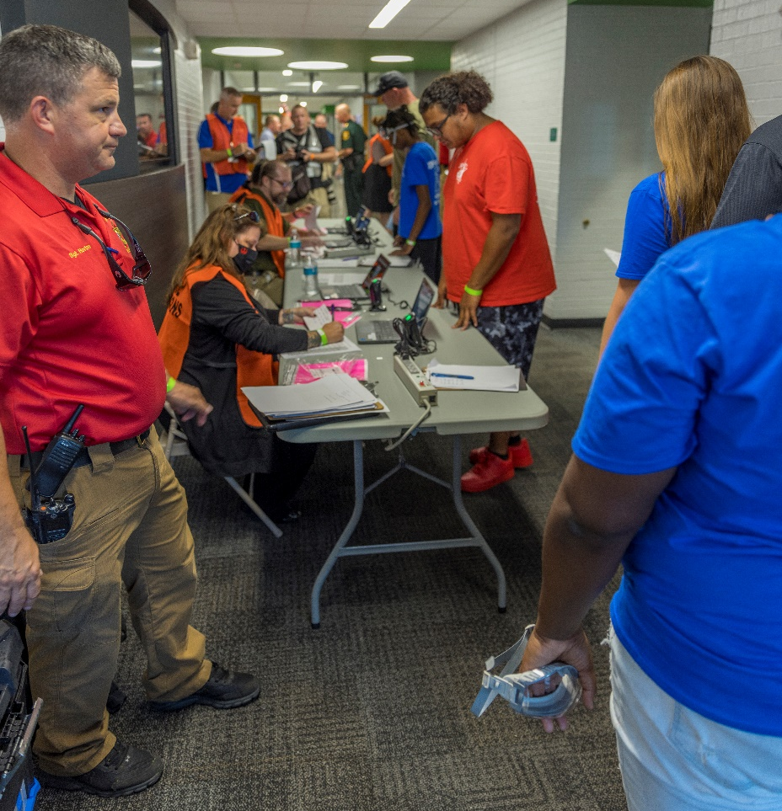
REGISTRAR RESPONSIBILITIES
Registrars will enter the subject into the software and determine who may be looking for them.
Affected persons will be issued a wristband with identification information.
The registrar will ask pre-determined investigative questions to the affected persons to determine if they area witness or have any evidence that needs to be collected.
PINELLAS COUNTY SHERIFF’S OFFICE

Slide 19
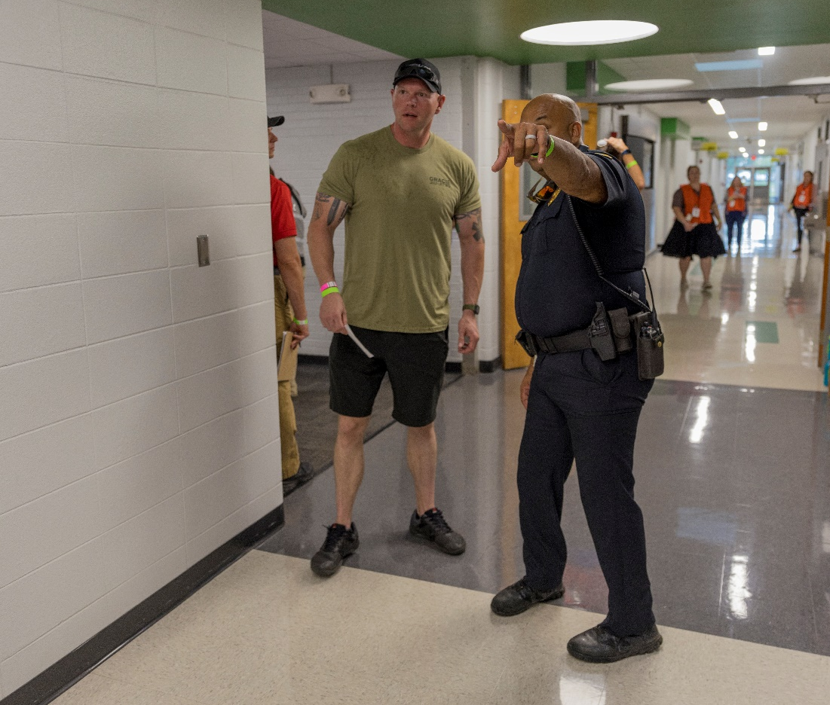
RUNNER RESPONSIBILITIES
Runners will filter subjects to the determined assembly area or evidence collection as determined by the registrars.
If an affected person does not need to be interviewed or does not have evidence, the runner will transfer them to the assembly area or directly to checkout if they wish to leave.
Runners will also be responsible for transferring subjects in the software as they move throughout the FRC.
PINELLAS COUNTY SHERIFF’S OFFICE

Slide 20
ENTRY/CHECK-IN FAMILY MEMBERS
Greeters will direct arriving family members to the registration check-in. Greeters will also assist in answering questions that may arise and explain how the process of the FRC is intended to operate.
Registrars will enter the subject into software, determine who they are looking for, and assign each of them a wristband.
Runners will transfer the subject to the appropriate assembly area. They will coordinate with other areas on updates as additional people are checked in and communicate information as it is obtained.
PINELLAS COUNTY SHERIFF’S OFFICE

Slide 21
ASSEMBLY AREAS
Taskforce members will answer questions and coordinate with runners if subjects need to move throughout the FRC.
Victim advocates will be there to assist in any emotional responses while subjects are awaiting reunification.
Affected persons may be reunited with family members in the assembly area while waiting to be interviewed and processed.
PINELLAS COUNTY SHERIFF’S OFFICE

Slide 22
DEATH NOTIFICATION AREA
Death notifications will be done in a nearby, isolated area for privacy.
Runners will escort family members through appropriate areas from initial check-in to checkout.
Chaplains and victim advocates will offer grief services.
Taskforce members will coordinate with detectives on scene to ensure family members have contact information for follow up communication.
PINELLAS COUNTY SHERIFF’S OFFICE

Slide 23
CHECKOUT
Affected persons and family members will exit through this area after being processed, requesting to exit, or after reunification.
Checkout personnel will list the subject as “checked out” in the software program and wristbands will be removed.
Taskforce members will coordinate with the transportation unit if the subject(s) needs transportation.
PINELLAS COUNTY SHERIFF’S OFFICE

Slide 24
RELIEF & DEMOBILIZATION
The demobilization process ensures the appropriate, efficient, and orderly cessation of FRC operations.
If the incident is expected to have long term needs by the affected persons, a Family Assistance Center may be established either at the FRC location or a separate location.
All taskforce members will be accounted for and the operations chief will verify the reunification process has been completed and all investigative needs have been met.
The incident will be debriefed at a later date.
PINELLAS COUNTY SHERIFF’S OFFICE

Slide 25
PINELLAS COUNTY FAMILY REUNIFICATION TASKFORCE
QUESTIONS?
PINELLAS COUNTY SHERIFF’S OFFICE

